Slide 1
An Overview & Management of Nephrolithiasis
A Urologist's Perspective
S Mattocks

Slide 2
Introduction to Nephrolithiasis
• Nephrolithiasis refers to renal calculi.
• It is a common condition affecting 10-15% of the population globally.
• Stones form when urine becomes supersaturated with stone-forming substances.

Slide 3
Pathophysiology
• Most stones form from calcium oxalate, calcium phosphate, uric acid, or cystine.
• Supersaturation leads to crystallization.
• Risk factors: dehydration, diet, genetics, certain medications.

Slide 4
Types of Stones
• Calcium Oxalate Stones: Most common type (about 80%).
• Uric Acid Stones: More common in patients with acidic urine.
• Struvite Stones: Often associated with urinary tract infections.
• Cystine Stones: Rare, genetic disorder causing cystinuria, autosomal recessive.

Slide 5
Clinical Presentation
• Symptoms: Severe flank pain, hematuria, nausea, vomiting.
• Pain typically radiates to the lower abdomen and groin.
• Pain may be intermittent (renal colic).

Slide 6
Diagnosis
• History and physical examination.
• Urinalysis: Microscopic hematuria, urine pH, presence of crystals.
• Imaging: Non-contrast CT is the gold standard.
• Ultrasound may be used in certain populations (e.g., pregnant women).

Slide 7
Acute Management
• Pain management: NSAIDs, opioids if necessary.
• Hydration: Encourages stone passage.
• Medical Expulsive Therapy: Alpha-blockers (e.g., tamsulosin) to aid stone passage.

Slide 8
Indications for Urologic Referral
• Intractable pain or vomiting.
• Stone size > 10mm.
• Infection or obstruction.
• Single kidney or renal impairment.

Slide 9
Imaging in Nephrolithiasis
• CT Scan: High sensitivity and specificity, identifies stone location and size.
• Ultrasound: Preferred for pregnant women and children.
• KUB (Kidney-Ureter-Bladder X-ray): Less sensitive, used for follow-up.

Slide 12
Surgical Interventions
• Extracorporeal Shock Wave Lithotripsy (ESWL): Non-invasive, uses shock waves to fragment stones.
• Ureteroscopy: Endoscopic removal or fragmentation of stones.
• Percutaneous Nephrolithotomy: For large or complex stones.

Slide 13
Extracorporeal Shock Wave Lithotripsy (ESWL)
• Non-invasive procedure.
• Indications: Stones < 2cm in size.
• Success rate depends on stone size, location, and composition, HU <900

Slide 15
Percutaneous Nephrolithotomy (PCNL)
• Indicated for stones > 2cm or complex stones.
• Involves percutaneous access to the kidney.
• High success rate but more invasive.

Slide 18
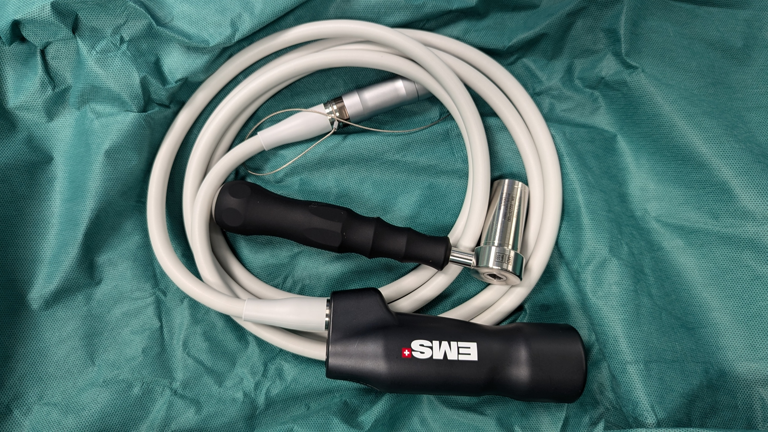
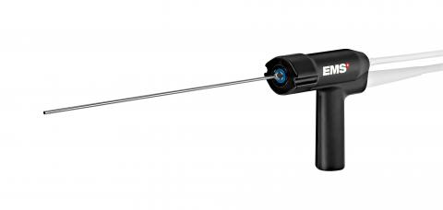

Slide 20
Ureteroscopy
• Minimally invasive endoscopic procedure.
• Flexible or rigid scope passed through the urethra and bladder.
• Laser lithotripsy used to fragment stones.

Slide 25
Medical Management After Stone Passage
• Prevention strategies based on stone composition.
• Increase fluid intake: At least 2-2.5 liters of urine output daily.
• Dietary modifications: Low sodium, reduced animal protein intake.

Slide 26
Metabolic Evaluation
• 24-hour urine collection to assess for stone risk factors.
• Serum studies: Calcium, phosphorus, uric acid, and parathyroid hormone levels.

Slide 27
Dietary Recommendations
• Increase fluid intake (water preferred).
• Reduce sodium intake.
• Avoid excessive protein, especially animal proteins.
• Limit oxalate-rich foods (e.g., spinach, nuts, chocolate).

Slide 28
Pharmacologic Therapy
• Thiazide diuretics: Reduce calcium excretion.
• Potassium citrate: Alkalinizes urine, useful for uric acid and cystine stones.
• Allopurinol: Reduces uric acid production in patients with hyperuricemia.

Slide 29
Follow-up
• Stone analysis after passage or removal.
• Repeat imaging to assess for residual stones.
• Long-term follow-up to prevent recurrence.

Slide 30
Recurrent Stone Prevention
• Address underlying metabolic abnormalities.
• Encourage dietary and lifestyle changes.
• Regular monitoring of urine parameters and stone risk factors.
• Joint Urologist/Nephrologist care

Slide 31
Case 1
• 45-year-old male presents with severe flank pain, haematuria.
• Imaging shows a 5mm stone in the distal ureter.
• Treatment plan: Pain control, hydration, tamsulosin for stone passage.

Slide 32
Case 2
• 60-year-old female with recurrent UTIs, large struvite stone.
• Treatment: Percutaneous nephrolithotomy (PCNL) due to stone size and infection.
• Post-surgical follow-up: Stone analysis and metabolic evaluation.

Slide 33
Complications of Nephrolithiasis
• Obstruction: Leads to hydronephrosis, potential renal damage.
• Infection: Can lead to pyelonephritis or urosepsis.
• Chronic kidney disease (CKD): Recurrent stones can impair kidney function.

Slide 34
Nephrolithiasis in Special Populations
• Pregnant Women: Ultrasound preferred for diagnosis, conservative management preferred.
• Pediatric Population: Focus on underlying metabolic causes.
• Elderly Patients: Higher risk of complications due to comorbidities.

Slide 35
Role of General Practitioners
• Early identification and referral to urologists when needed.
• Educating patients on preventive measures.
• Managing pain and hydration in acute settings.

Slide 36
Key Points to Remember
• Nephrolithiasis is a common condition with significant recurrence risk.
• Early diagnosis and management can prevent complications.
• Prevention strategies should focus on hydration, dietary changes, and addressing metabolic abnormalities.

Slide 37
Questions and Discussion
• Thank you for your attention!
• Any questions or cases you'd like to discuss?

Slide 38
St Liborius holding bladder stone. Carving in the St Marcellino Convent Chapel, Naples.

