Slide 1
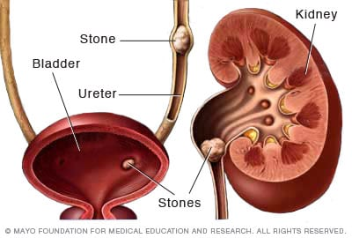
Overview and Medical Management of Nephrolithiasis – 14.11.2024

Slide 2
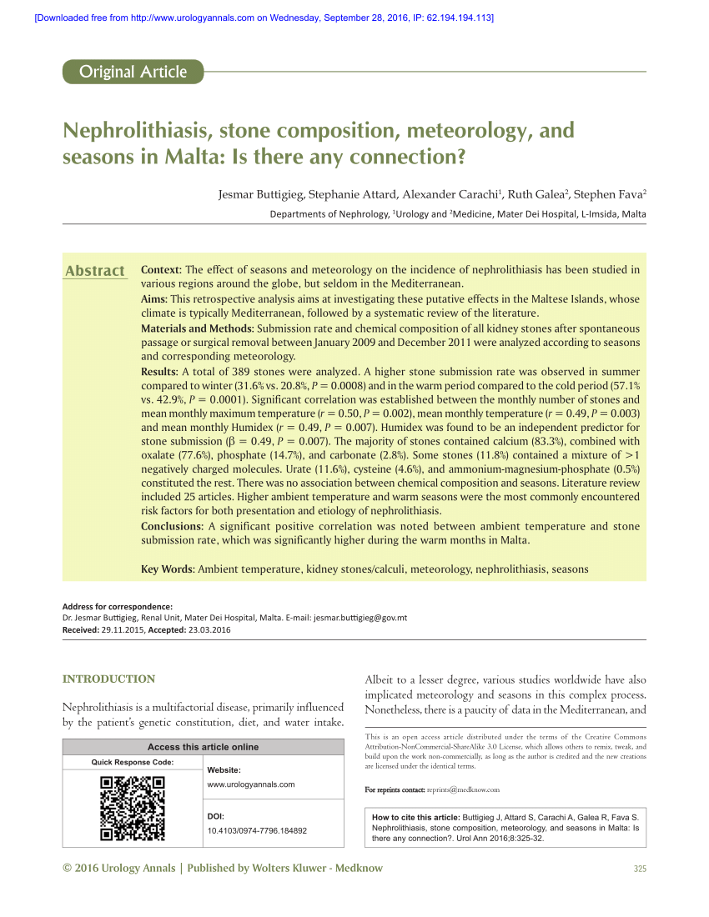
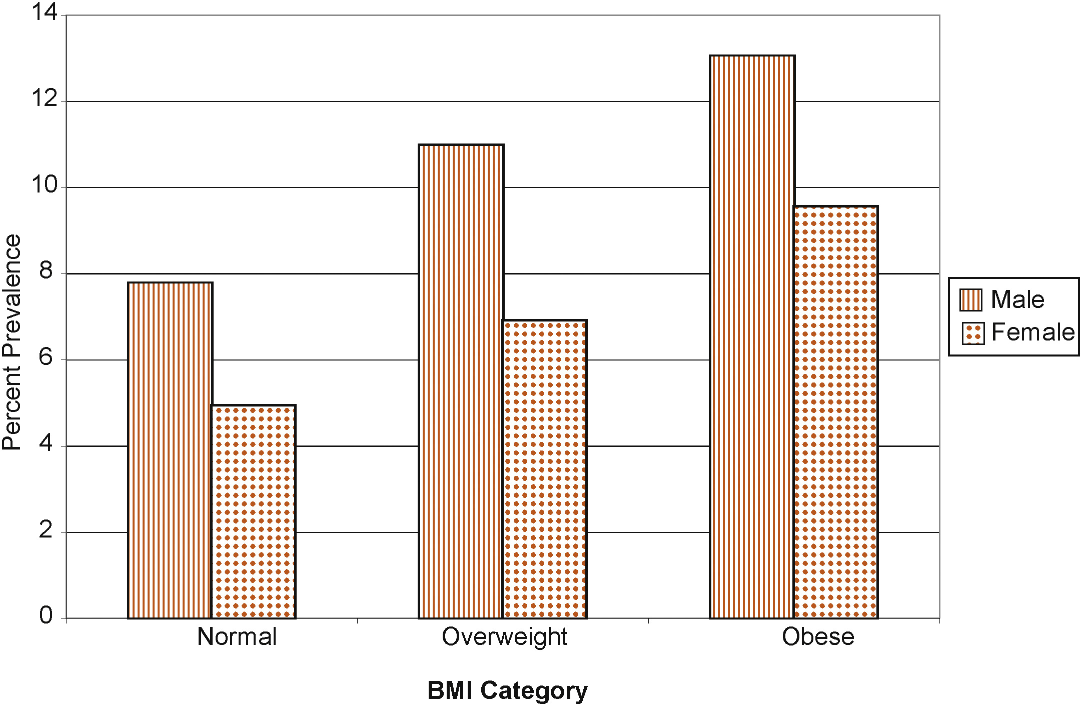
Epidemiology

Slide 3
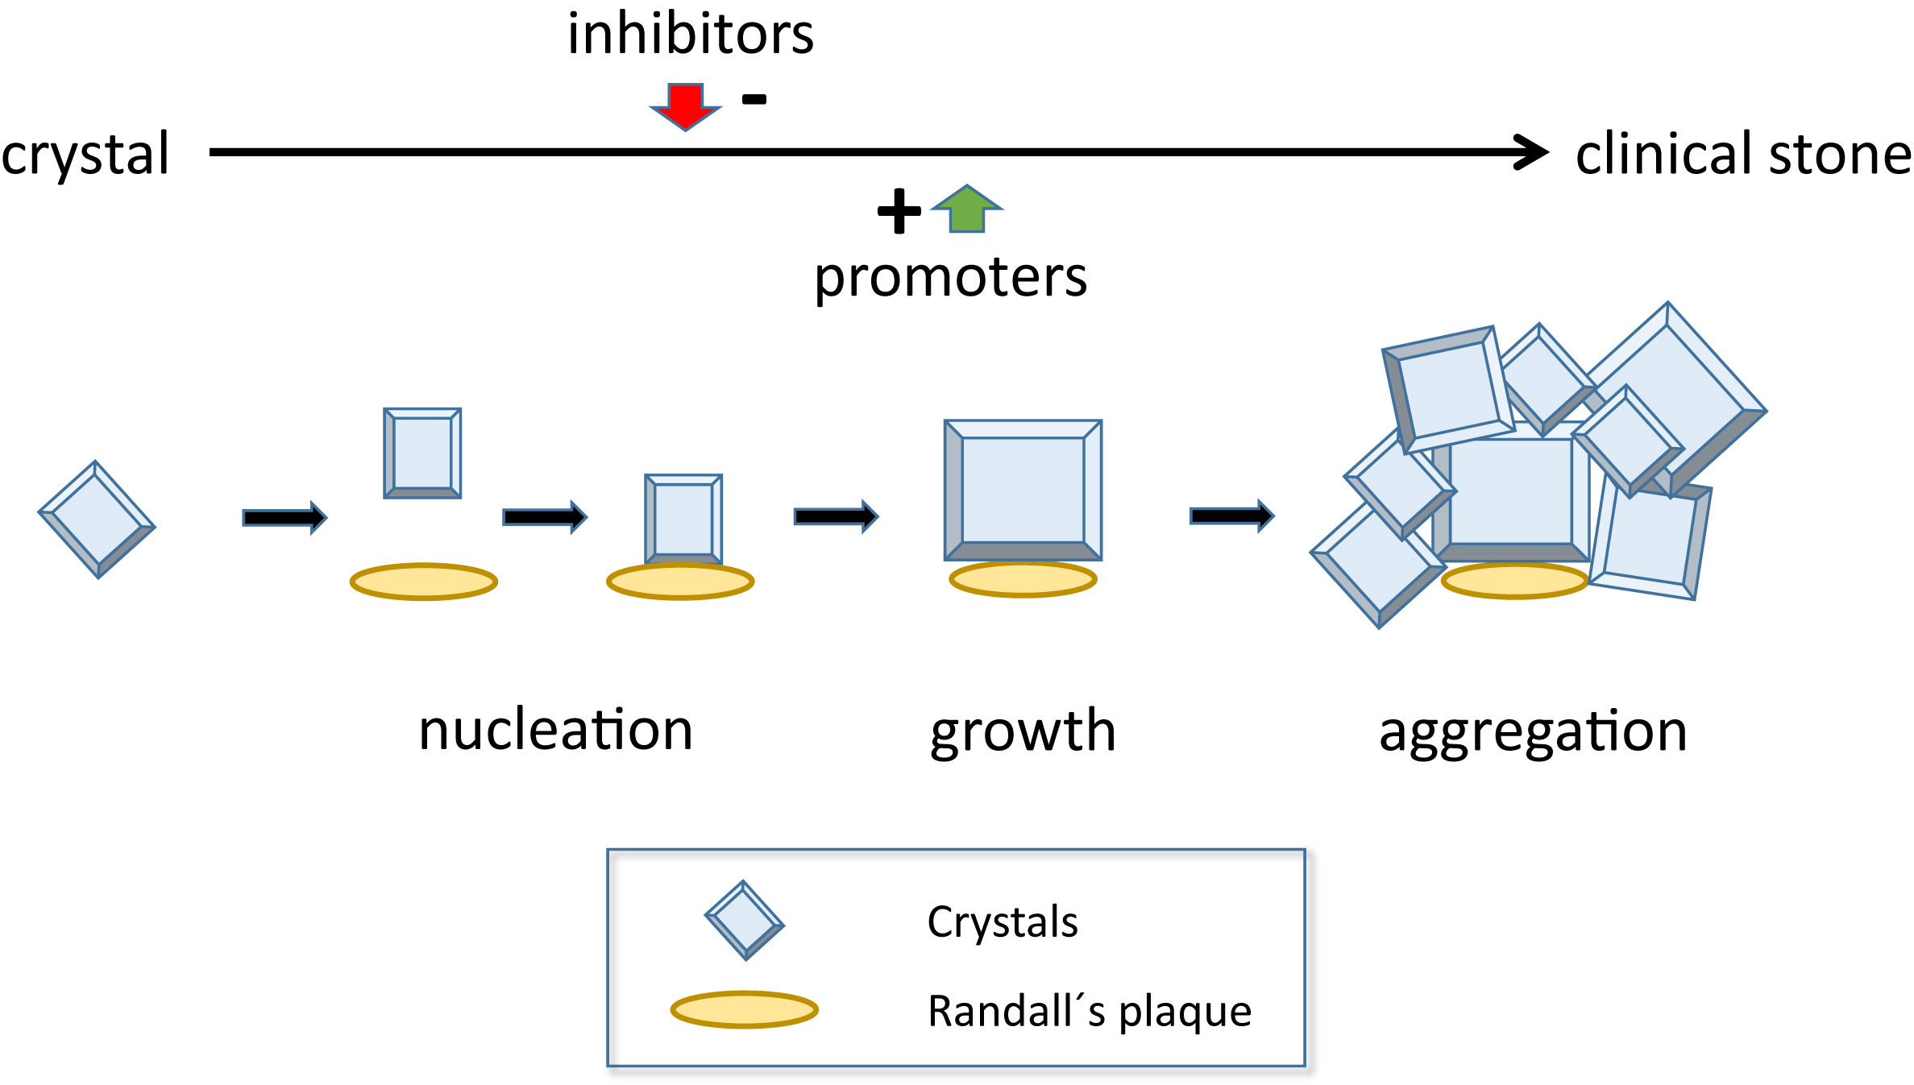
American Journal of Kidney Diseases 2016 68973-985DOI: (10.1053/j.ajkd.2016.05.016)
Notes:
Mechanisms of stone formation.

Slide 4
Recurrence Rates
30% at 5years
50% at 10 years
80% at 20 years

Slide 5
Risk factors
Urinary factors:
biochemical abnormalities in urine
urine volume
urine pH
Dietary factors
Medications
Non-modifiable risk factors:
family history
genetic susceptibility
variety of medical conditions

Slide 6
Stone Composition

Slide 7
Evaluation of patient with first stone episode - 1
History: medications, occupation, FH of stones or other kidney disease (e.g. PKD), IBD (e.g. Crohn’s)
Diet: intake of protein, purines, sodium, fluids, oxalate and calcium
Imaging: obtain or review available imaging studies to quantify stone burden
are there other stones present?
any anatomically important kidney disorders e.g.
PKD, MSK

Slide 8
Evaluation of patient with first stone episode - 2
Serum - electrolytes, creatinine,
- hypercalcaemia, values > 2.5mmol/l, consider
primary HPT (do PTH level!)
sarcoidosis
CYP24A1 mutations and vitamin intake
Serum bicarbonate < 22mol/l
consider distal RTA
Magnesium, phosphate, uric acid

Slide 9
Evaluation of patient with first stone episode - 3
Urinalysis
High urine pH: RTA
Low urine pH: struvite stones
Low urine pH: uric acid stones
Crystalluria
Urine Culture
Stone analysis
Xray diffraction
Infrared spectroscopy

Slide 10
Evaluation - additional metabolic testing in
High-risk first-time stone formers
More than 1 stone on initial presentation
Recurrent stone formers
Paediatric age group
Solitary kidney

Slide 11
High risk First time stone former
Family history
GI e.g. bowel resection, colitis, coeliac, bariatric surgery
Bone Disease
Gout
Recurrent UTI
Nephrocalcinosis
Type 2 diabetes mellitus
Obesity

Slide 12
Metabolic testing should consist of 24hour urine collections obtained on a random diet
Urine should be tested for:
Volume
pH
Calcium
Oxalate
Citrate
Uric Acid
Sodium
Creatinine

Slide 13
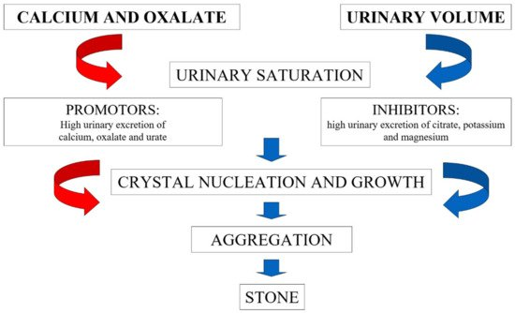
CALCIUM STONE DISEASE Urinary risk factors (ALONE OR IN COMBINATION)
HYPERCALCIURIA – MOST COMMON
HYPERURICOSURIA
HYPOCITRATURIA
HYPEROXALURIA
LOW URINE VOLUME

Slide 15
Hypercalciuria
> 250mg/day (6.24mmol/day) in females
> 300mg/day (7.49mmol/day) in males
Another definition: > 4mg/kg (0.1mmol/kg) per day
Arbitrary threshold values
1-5% with HYPERCALCAEMIA (especially PHPT)
95% with NORMOCALCAEMIA
Exclude distal RTA, steroids and frusemide therapy in normocalcaemic hypercalciuria
IDIOPATHIC HYPERCALCIURIA

Slide 16
Hypercalciuria – role of Sodium and thiazides
Oral sodium intake is a major determinant of renal calcium excretion
An increased Na intake of 100mmol / day will increase urinary Ca by 50mg / day
Excess urinary Na will also block the hypocalciuric action of thiazides
Thiazides: augment Ca reabsorption in distal tubule; mainstay of therapy of hypercalciuria (‘perfect’ correction in renal leak hypercalciuria; “compensates” in absorptive hypercalciuria)
use long acting
supplement K if needed
decrease stone formation rate from 2.94 to 0.05/year (p<0.001)

Slide 17
High urinary oxalate
‘normal’ < 45mg/day (0.5mmol/day)
Collect urine for 24 h in the presence of 10 ml of concentrated HCl
Bio Scientia reference lab normal range for adults
7 – 44 mg/day males
4 – 31 mg/day females
Hyperoxaluria: > 45mg/day (>0.5mmol/day) in adults
> 33mg/1.73m2/day (>0.37mmol/1.73m2/day) in children
Relative contribution of endogenous and exogenous oxalate to urine oxalate excretion remains uncertain
DIETARY CALCIUM DECREASES OXALATE ABSORPTION IN THE GUT

Slide 19
Low urinary citrate
Hypocitraturia: < 320mg/day
Collect urine for 24 h in the presence of 10 ml of concentrated hydrochloric acid.
Cerba reference v: women: 1.30 – 6.00 mmol/24h men: 0.59 - 5.17 mmol/24h
Citrate excretion is pH-dependent
CAUSES: chronic metabolic acidosis (chronic diarrhoea), RTAs, carbonic anhydrase inhibitors (Diamox, topiramate), ureteral diversion, high animal protein diet, low veg/fruit diet (low urinary K)

Slide 20
High uric acid in urine
Hyperuricosuria > 750mg (4.5mmol) in females
> 800mg (4.8mmol) in males
Risk factor for calcium stones (a NEJM study showing allopurinol beneficial in hyperuricosuric CaOx stone formers but ‘normal’ urinary calciums); nidus theory; could allopurinol lower stone risk by some other mechanism?)
Risk factor for uric acid stones (MAIN RISK here is PERSISTENTLY LOWER pH)

Slide 21
Three contributors to uric acid stones
Low urine pH _ overweight, metabolic syndrome, diabetes
Low urine volume – diarrhoea, low fluid intake
High urinary uric acid – higher animal protein intake (also lowers urinary pH), gout, myeloproliferative disease, genetic disorders e.g. Lesch- Nyhan syndrome

Slide 22
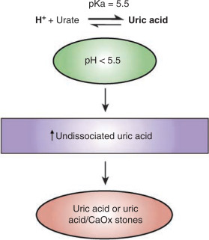
Kidney International 2009 75585-595DOI: (10.1038/ki.2008.626)
Notes:
Physicochemical scheme for the development of uric acid stones.

Slide 23
Diet therapies - guidelines
In all stone formers, recommend a fluid intake that will achieve a urine volume of at least 2.5 litres daily. (Standard; Evidence Strength: Grade B)
In calcium stone formers and relatively high urinary calcium, limit sodium intake and consume 1,000-1,200 mg per day of dietary calcium. (Standard; Evidence Strength Grade: B)
In calcium oxalate stone formers and relatively high urinary oxalate, limit intake of oxalate-rich foods and maintain normal calcium consumption. (Expert Opinion)
In calcium stone formers and relatively low urinary citrate, increase their intake of fruits and vegetables and limit non-dairy animal protein. (Expert Opinion)
In uric acid or calcium stone formers and relatively high urinary uric acid, limit intake of non-dairy animal protein. (Expert Opinion)
In cystine stone formers, limit sodium and protein intake. (Expert Opinion)

Slide 24
Pharmacologic therapies - 1
Clinicians should offer thiazide diuretics to patients with high or relatively high urine calcium and recurrent calcium stones.
Clinicians should offer potassium citrate therapy to patients with recurrent calcium stones and low or relatively low urinary citrate.
Clinicians should offer allopurinol to patients with recurrent calcium oxalate stones who have hyperuricosuria and normal urinary calcium.
Clinicians should offer thiazide diuretics and/or potassium citrate to patients with recurrent calcium stones in whom other metabolic abnormalities are absent or have been appropriately addressed and stone formation persists.
(All guidelines Standard; Evidence Strength Grade B)

Slide 25
Pharmacologic therapies - 2
Clinicians should offer potassium citrate to patients with uric acid and cystine stones to raise urinary pH to an optimal level. (Expert Opinion)
Clinicians should not routinely offer allopurinol as first-line therapy to patients with uric acid stones. (Expert Opinion)
Clinicians should offer cystine-binding thiol drugs, such as alpha-mercaptopropionylglycine (tiopronin), to patients with cystine stones who are unresponsive to dietary modifications and urinary alkalinization, or have large recurrent stone burdens. (Expert Opinion)
Clinicians may offer acetohydroxamic acid (AHA) to patients with residual or recurrent struvite stones only after surgical options have been exhausted. (Option; Evidence Strength Grade B)

Slide 26
Follow up
Obtain a single 24-hour urine specimen for stone risk factors within six months of the initiation of treatment to assess response to dietary and/or medical therapy.
After the initial follow-up, obtain a single 24-hour urine specimen annually or with greater frequency, depending on stone activity, to assess patient adherence and metabolic response.
Obtain periodic blood testing to assess for adverse effects in patients on pharmacological therapy. (Standard; Evidence Strength Grade: A)
Obtain a repeat stone analysis, when available, especially in patients not responding to treatment.
Monitor patients with struvite stones for reinfection with urease-producing organisms and utilize strategies to prevent such occurrences.
Periodically obtain follow-up imaging studies to assess for stone growth or new stone formation based on stone activity (plain abdominal imaging, renal ultrasonography or low dose computed tomography [CT]).
(Expert Opinion)

