Slide 1
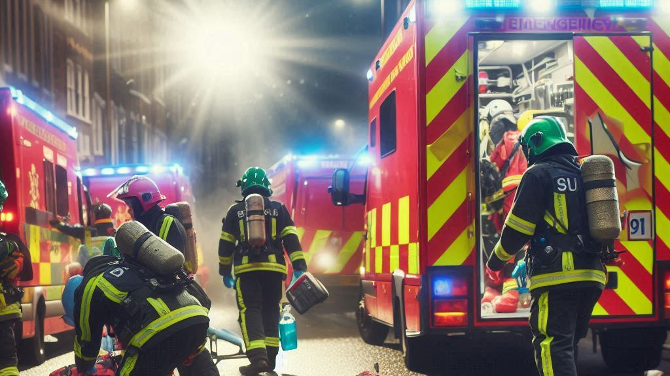
Out-of Hospital Trauma Management Cases – Essentials Relevant to the GP
Dr Nicole Marie Scicluna Calleja and Dr Mario Zerafa

Slide 2
Outline
Cases
Safety and Initial Assessment
Airway, Breathing, Circulation
Specific Cases
Non-technical Skills
Handover
Conclusion

Slide 3
Case

Slide 4
Initial Assessment: Safety First

Slide 5
Initial Assessment: Safety First
Check surroundings
Hazards: fire, water, electricity, roads, cars
Stop traffic
If safe, approach

Slide 6
Initial Assessment: 5 seconds

Slide 7
Initial Assessment: 5 seconds
5-second round: team leader has a quick look
Airway problems
Massive haemorrhage
Cardiac Arrest
If any of these identified – tackle first and fast

Slide 8
A - Airway

Slide 9
Airway
Look, Listen, Feel – immediately tells you if airway is open, partially obstructed, completely obstructed, or in danger.
Look for chest rise, listen for normal breath sounds, feel amount of air expelled
Partial: added sounds, gurgling, abnormal movements of chest or neck
Relief: maneuvers – tilt or jaw thrust, adjuncts may be used – beware Head Injury
BVM may be safest. Remember MILS – manual in-line stabilisation of the cervical spine

Slide 10
B - Breathing

Slide 11
Breathing
RIPPA – Rate, Inspection, Palpation, Percussion, Auscultation
Tracheal position
Beware tension pneumothorax!
Beware the back of the chest – stab wounds, flail chest (more than 2 ribs broken)
Ventilation may be difficult or get more difficult
Identify need for oxygen – SpO2 if possible

Slide 12
C - Circulation

Slide 13
Circulation
SHOCK: the major killer – inadequate perfusion!
Hypovolemic, Obstructive, Cardiogenic, Neurogenic, Anaphylactic
HR ↑↓, BP ↓, CRT >2s, RR ↑↓
Penetrating objects: to remove or not to remove?
Venous access: preferable but only if available and possible (IV, IO)

Slide 14
Circulation
Prevent further haemorrhage!
Direct pressure
Tourniqets
Pelvic binders
Splinting long bones

Slide 15
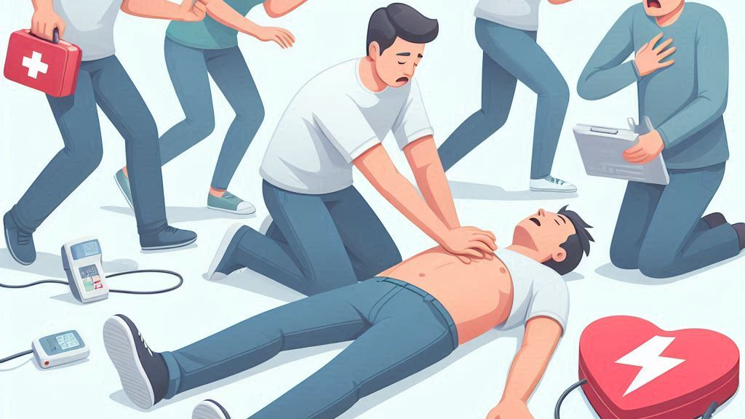
Cardiac arrest

Slide 16
Cardiac arrest
Traumatic Cardiac Arrest
Medical Cardiac Arrest
ALS + Treat the cause
Hypoxia, Hypovolemia
Tension Ptx, Tamponade
Very complex!
Treat as per ALS
Call for help
CPR
Shock

Slide 17
Specific Cases

Slide 18
Burns
Safety when assessing
Two major killers: Airway, Hypovolemia
Prevent further fluid loss, support airway

Slide 19
Abdominal Trauma
Look for signs: bruising, guarding, flank pain or bruising, scrotal or labial bruising
Mechanism of injury
Alert if possible – hidden haemorrhage

Slide 20
Pelvic Trauma
Have a look: obvious deformity? Bruising
Tenderness over hips
Can bleed fast?
Pelvic binder

Slide 21
Pregnancy
First trimester little injury risk; 2nd protected despite injury; 3rd trimester very much in danger
Placenta not as elastic as tissues - may shear!
ABC are different in pregnant woman
Beware pre-ecclampsia
Handover gravid status to 112

Slide 22
Head Injury
Level of consciousness – AVPU? GCS?
Suspect according to injury
Anything obvious on examination: laceration, bruising, conscious level?
Beware difficult airways – support and report

Slide 23
Spinal Injury
Very common, protect the cervical spine
MILS, Spinal blocks, Spinal boards, collars
Assess: neck pain, neurological signs.
The more severe the accident and other injuries, the more likely the damage to the spine.
Log-rolling
Neurogenic shock: signs of shock with ↓HR

Slide 24
Injuries to Extremities
These can be dangerous and bleed!
Possible broken bones: swelling, bruising, tenderness, obvious deformities – splinting and possibly need tourniquets
Blast injuries – beware bleeds, wounds + contamination, projectiles, severe swelling, burns

Slide 25
Paediatrics
Some special considerations

Slide 26
Paediatrics
Major trauma is relatively rare, BUT
Leading cause of death above 1yo
10% of all trauma fatalities occur in under 16yo
Traumatic brain injury is leading cause of death and disability in all paediatric age groups
Chest injuries are second
Uncontrolled haemorrhage is the leading cause of preventable death in children
No place for HYPOTENSIVE resuscitation in children
Very prone to HYPOTHERMIA

Slide 27
Paediatrics
cABC approach (same as in adults)
(5 second round)
c = major haemorrhage
A = airway obstruction
B = chest injuries
C = circulatory shock

Slide 28
Paediatrics
AIRWAY and BREATHING
Start by talking to child, introduce yourself, explain, comfort (if appropriate) – this also allows neuro assessment.
If any sign of airway obstruction, provide basic airway management. ( NB Airway adjuncts! )
Beware blood in airway, also vomit, swollen tongue.
NB: Chest movement on its own is NOT a sign of breathing: Airway can still be obstructed or at risk.

Slide 29
Paediatrics
AIRWAY and BREATHING
Assess breathing pattern – can be difficult if child is crying, but it can be helped by reassurance +/- analgesia
Rate, symmetry, work of breathing, effecftivity
Inspect, palpate, percuss, auscultate the chest (pulmonary contusions are commonest thoracic injury and may not be obvious initially)
Inspect, palpate the neck
Bag, valve, mask (BVM) ventilation (or mouth to mouth/nose) can be helpful in most cases until expert help arrives.

Slide 30
Paediatrics
Circulation
Stem any obvious bleeding. (NB scalp lacerations)
Monitoring of pulse rate is very important especially the trend (Crying, anxiety, and pain effect HR).
SpO₂ and BP can be difficult to determine in a restless child
CRT and ECG if available are very helpful.
NB Children compenstae for hypovolamia with increase in HR.
Drop in BP is a very late sign and means decompensation has occurred
BRADYCARDIA in a shocked child usually means CARDIAC ARREST is imminent.

Slide 31
Paediatrics
Cervical Spine
Spinal immobilization: ONLY in coopeartive or unconscious children – SHOULD NEVER BE ENFORCED
In < 8 yo children, C1 – C3 are the commonest C vertebrae injured
Vertebral column and spinal cord injuries
Thoracic and lumbar vertebrae injuries are rare but are commonest in multiply injured.
In >10yo, 44% of vertebral column and spinal cord injuries are due to sport / recreational activities

Slide 32
Paediatrics
Brain injury
Isolated head injury occurs in > 50% of severely injured children
Leading cause of death and permanent disability
20% of traumatic brain injury require emergency craniotomy for evacuation of sub- or extradural haematoma
Done as fast as possible, < 4h from time of injury

Slide 33
Paediatrics
Abdominal injury (including pelvic fracture)
Third most common injuries after head and extremity
Commonest cause of circulatory shock
Solid abdominal organs are relativly larger and less protected than in adults
90% of these injuries can be managed conservatively or with interventional radiology
Blood transfusion still necessary
Respiratory compromise can complicate abdominal injury
Injuries to pancreas and duodenum are typical of bicycle handlebar trauma

Slide 34
Paediatrics
Limb injuries
Rarely a cause of mortality on their own but ofc may be associated with more serious internal injuries
No need for immediate definitive repair
Stabilisation of long bone #s is an important part of initial resuscitaion as it reduces blood loss, pain and incidence of multiple organ dysfunction syndrome

Slide 35
Paediatrics
Beware non-accidental injury !
History and type of injury incompatible
Unexplained delay to seek medical help
Change in the story with passing of time
Bone fractues in non-mobile child
Extent of scalds or burns incompatible with history
Be familiar with reporting procedure

Slide 36
Non-technical Skills

Slide 37
Non-technical skills
Leadership
Communication
Situational awareness

Slide 38
Handover

Slide 39
Handover: SBAR
SBAR: Situation, Background, Assessment, Recommendation
KISS: Keep it Short and Simple (Sell)

Slide 40
Conclusion

Slide 41
Conclusion and Summary
Trauma cases can be complex and high-intensity exercises for all involved.
Safety first!
GP – appropriate assessment and interventions to prevent further detioration.
Call for help fast!
Good handover!

Slide 42
Thank you
Questions?

