Slide 1
Medical Therapies for Endometriosis Pain
THE GYNAECOLOGY PELVIC PAIN APPROACH
Mr Max Brincat Dip (Gesea),BSc(Hons), PGDip , Mres, MD, MRCOG

Slide 2
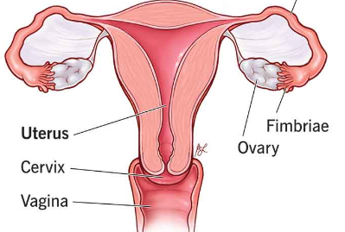
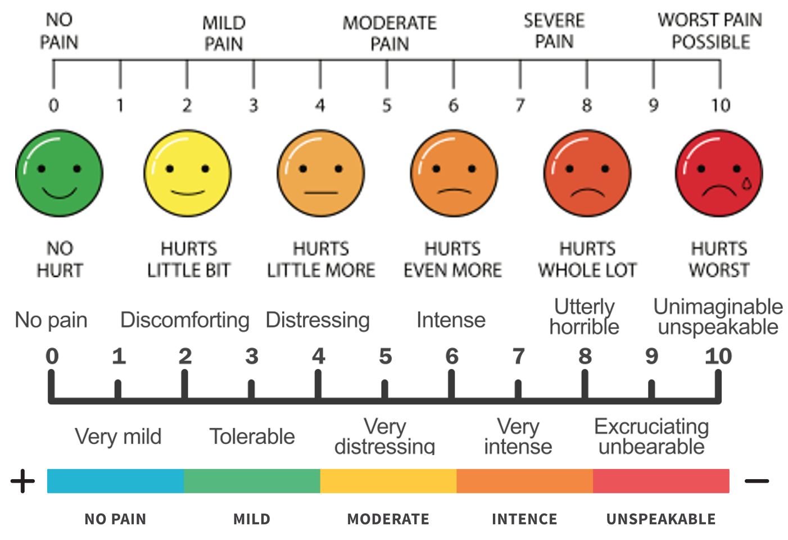
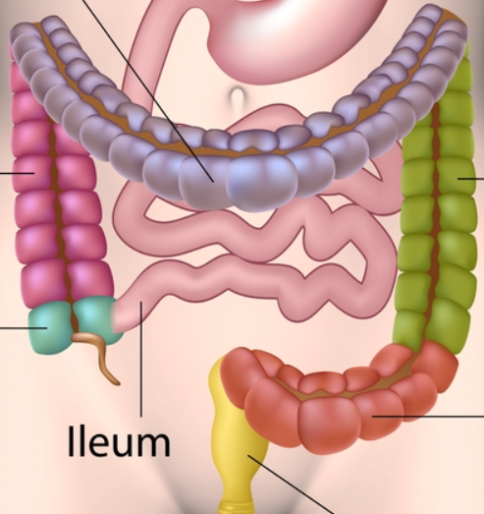
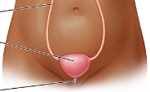
Key symptoms indicating severity of pelvic pain
Dysmenorrhea
Menorrhagia
Dyspareunia
Dyschesia
Hematochezia
Dysuria
Haematuria
VAS Score

Slide 3
Diagnosis of Endometriosis
Radiological assessment
Transvaginal Ultrasound Scan
Pelvic MRI
Surgical Diagnosis
Diagnostic Laparoscopy (See and Treat?)
Notes:
Advances in radiological imaging techniques and reporting have improved the ability to diagnose endometriosis with out requiring surgery. A Diagnostic Laparoscopy is no longer the gold standard diagnostic technique.

Slide 4
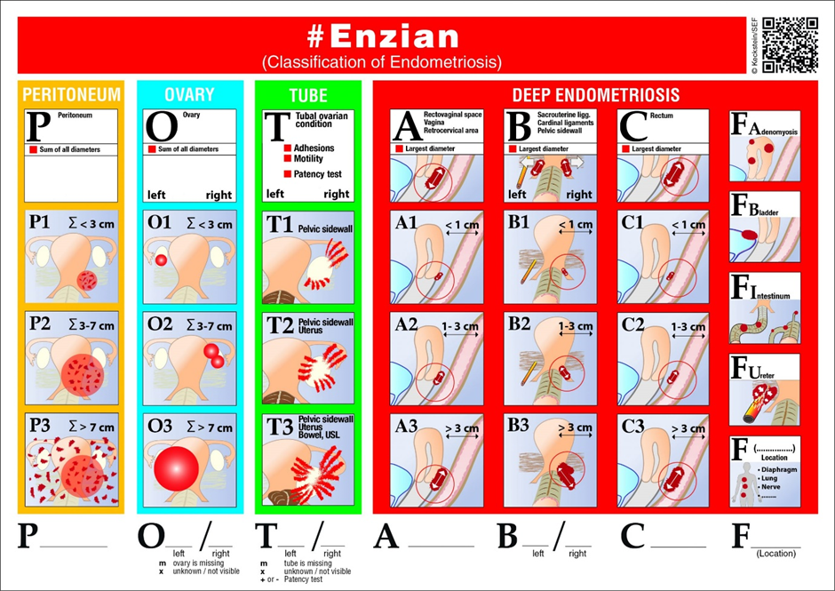
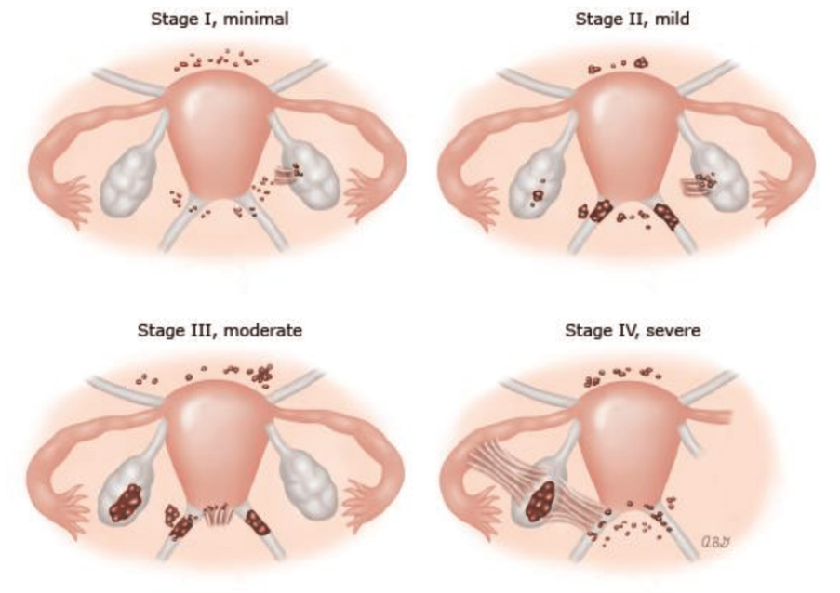

Slide 5
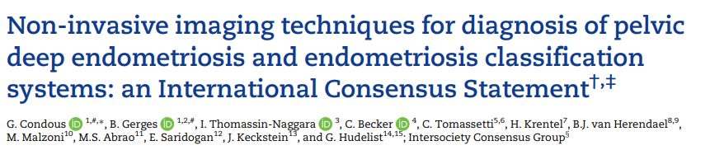
The test performance of any imaging technique for the detection of DE is operator-dependent and will increase with exposure, level of training and skills, and experience of the operator.
Patients with a plan for surgical intervention for endometriosis should undergo preoperative imaging for the detection of DE performed by adequately trained operators
TVS performed by adequately trained operators is recommended as the first-line imaging tool due to its availability, good test performance, cost efficacy, and its low environmental impact when compared to other imaging methods

Slide 6
Radiological Diagnosis of Endometriosis
Allows for:
The identification and mapping of endometriosis prior to commencing treatment
Better preparation prior to surgical management and reduce the risk of repeat surgical interventions
Reduce to risks associated with surgical management such as exacerbation of pain

Slide 7
Medical Therapies
Response to empiric therapy does not confirm the diagnosis of endometriosis.
Treatments should be considered suppressive rather than curative
The main objective of medical management is to prevent recurrence and reduce symptoms
Medical therapies will not increase fecundity or resolve endometriomas or deeply infiltrating disease
The effectiveness of medical options for reducing symptoms is comparable

Slide 8
Optimal Regimen is based of Multiple Factors
Patient Age
Patient preference
Reproductive plans
Pain severity
Degree of disease
Treatment costs
Treatment availability
Intended duration
Treatment risks and side effect profiles

Slide 9
Non-Steroidal antiinflammatory drugs
Alone are probably of minimal effectiveness in patients with endometriosis

Slide 10
Pathophysiology
The progesterone (P4) and estrogen (E2)-responsive signaling pathways that are integral for early pregnancy success, are primarily induced through their cognate nuclear receptors, the progesterone receptor (PGR) and estrogen receptors (ESR1 and ESR2), respectively.
E2 induces epithelial proliferation to build endometrial thickness during the proliferative phase of the menstrual cycle, then P4 inhibits E2-induced proliferation and allows stromal cells to begin decidualization during the secretory phase

Slide 11
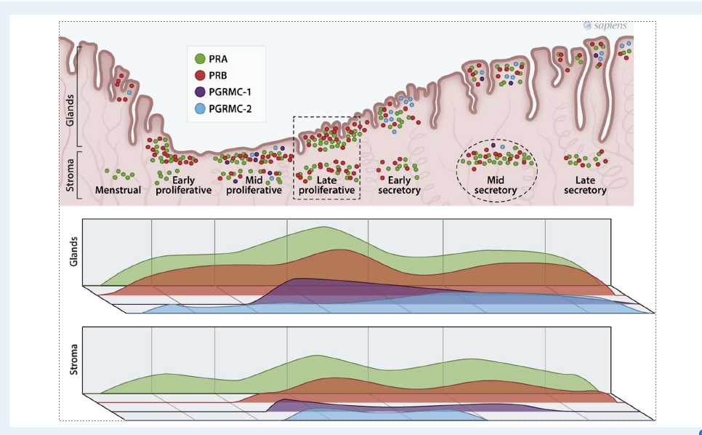

Slide 12
Progesterone Receptors and progesterone signaling
PGR expression
E2 action (ESR1)
PGR expression is induced by E2 action through ESR1, and in turn PGR inhibits ESR1 expression

Slide 13
Endometriosis is a “benign”, heterogeneous E2-dependent, and P4-resistant inflammatory condition that mainly affects the peritoneal cavity and ovary close to the uterus but has also been reported in distal organs such as the lungs and brain.
Dysregulation of steroid hormone signaling is common in many uterine pathologies such as endometriosis
When the tightly regulated balance of epithelial-stromal P4 and E2 signaling is lost, P4 resistance and E2 dominance are prone to ensue, leading to uterine disease such as endometriosis.

Slide 14
Functional dysregulation in endometriosis
Ovarian steroid hormones synthesis
Downstream signaling targets

Slide 16
Progesterone Resistance
Endometrial tissue fails to respond to P4 exposure
Resulting in the failed induction of PGR activation, or P4 target gene transcription in the present of bioavailable P4.
Flores et al 2018 confirmed direct correlations between PGR loss with loss of P4-responsiveness
Prentice et al, Broi et al, Zanatta et al found no significant difference in PGR levels
Studies have found decreases in PR-B in endometriosis

Slide 17
Estrogen in Endometriosis
Endometriosis and development is driven by the upregulation of E2-Induced cell proliferation and inflammation.
Local E2 levels are increased in endometriosis due to upregulation of E2-producing p450 aromatase expression and reduction in 17-β hydroxysteroid dehydrogenase type 2.
17-β hydroxysteroid dehydrogenase type 2 is normally induced by p4 to convert E2 to the less potent estrone but is decreased in P4-resistant conditions
Reports are still mixed on where ESR-1 / ESR-2 ratios / regulation are altered in endometriosis

Slide 18
ESR-1 / ESR-2
The loss of ESR1 in lesions has been suggested as a possible explanation for the loss of PGR
Increase in ESR-2 levels in lesions may be responsible for increased lesion survival and inflammation because E2 can act through ESR 2 to induce the cyclooxygenase-II *COX2)-prostaglandin E2 (PGE2) feedback loop

Slide 19
Hormonal Therapy
The goal of hormonal therapy is to induce a local hypoestrogenic state by suppressing ovulation.
The resulting amenorrhea or hypomenorrhea reduces the conversion of arachidonic acid to prostaglandins with menses and subsequently lessens dysmenorrhea and pelvic pain

Slide 20
Hormone Receptor Heterogenicity
Nisolle et al.24 found “heterogeneity of estrogen receptor α and progesterone receptor distribution in lesions of DIE in untreated women, or during exposure to various hormonal treatments”.
This could be because DIE nodules are poor responders to different endocrine treatments

Slide 21
Available Hormonal Therapies
Estrogen-Progestin combinations
Progestins
GnRH agonists
Androgenic steroids
Antiandrogens
GnRH antagonists
Aromatase inhibitors
Selective progesterone receptor modulators

Slide 23
Estrogen-progestin combinations
Continuous rather than cyclic administration appears to more effective in reducing the recurrence of dysmenorrhea but not non-cylic pelvic pain or dyspareunia (ESHRE)
OCPs thin the endometrium & inhibit ovarian function, thereby reducing the amount of bleeding and inhibiting the metabolism of arachidonic acid to prostaglandins effectively relieving cramping and pain
Cause decidualisation of endometriotic implants and decrease cell proliferation

Slide 24
Estrogen-progestin combinations
Continuous versus cyclic OCP use for the treatment of endometriosis-associated pain and reported that the continuous regimen appears to be more efficacious with regards to dysmenorrhea recurrence (RR 0.24; 95%CI 0.06-0.91) Muzii, et al., 2016
Nonsignificant differences between continuous and cyclic OCP use were reported for chronic pelvic pain and dyspareunia, and a trend toward lower cyst recurrence rates for a continuous OCP (RR 0.54; 95%CI 0.28 to 1.05).

Slide 25
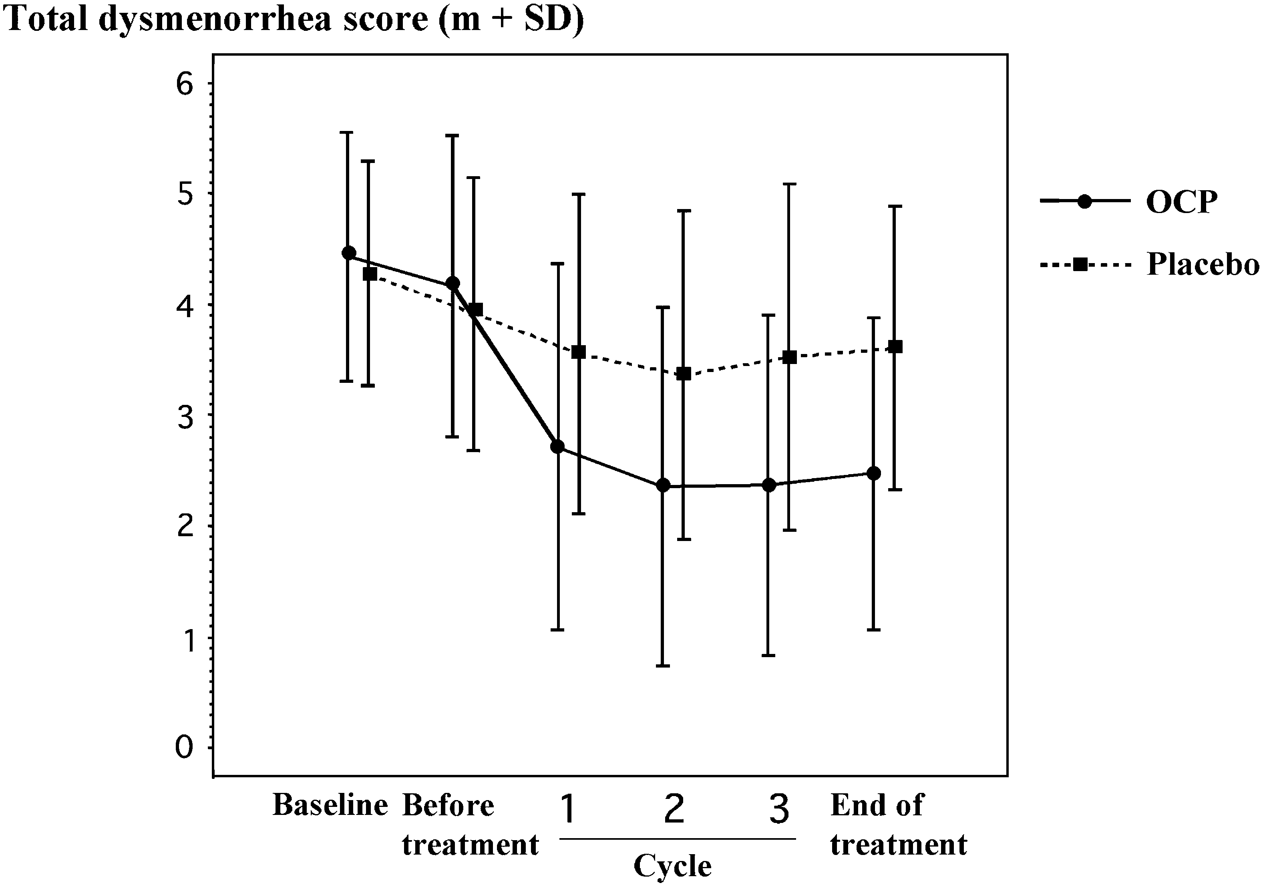
Combined Oral Contraception
A Placebo-controlled, double-blind, randomized trial confirms improvement of dysmenorrhea and reduction in the size of endometriomas greater than 3cm taking combined oral contraceptives compared with placebo
Harada et al 2008

Slide 26
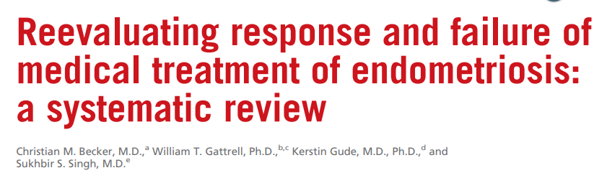
The rate of patients experiencing pain symptoms at the end of treatment was higher with COC, Vaginal ring and pach compared to GnRH-a and Progestins

Slide 27
Estetrol 15mg / drospirenone 3mg
Estetrol E4 is a natural estrogen
Moderate but selective affinity for estrogen receptors (Ers)
Higher preference of Erα receptor
Resembles the activity of SERMs
Showing pro & anti-estrogenic effects
Pro – in brain, endometrium, bone, uterus and ovaries
Anti – CNS and epithelial breast
THERE is NO DATA about E4 effects in pathology

Slide 28
Compared E4 and 17β-estradiol (E2) effects using two human endometriotic cell lines (11Z and stromal Hs832 cells) and primary cultures from endometriotic patients
E4 did not induce proliferation or migration in these cells
Raised levels of PRs which boosts the response to progesterone
E4 are functional proteins that elicit activation in PRs-related genes, required to restore P4 response in patients who develop resistance or prevent its appearance

Slide 29
Progestogens
By binding to progesterone receptors (PRs), these synthetic compounds can induce anti-estrogenic, pro-apoptotic, anti-inflammatory and anti-neurogenic effects, resulting in pain relief and interruption of pathogenic mechanisms within the endometriotic lesions

Slide 30
Progestogens
Norethisterone Acetate 19-nortestosterone derivative
Dienogest 19-nortestosterone derivative
Levonogestrel 17α-ethynyl-18-methyl-19-nortestosterone
Medroxypregesterone 17-OH progesterone derivative
Desogestrel derivative of norethisterone
Gestrinone derivative of norethisterone
Etonogestrel-releasing subdermal implant derivative of norethisterone
Danazol derivative of ethisterone

Slide 31
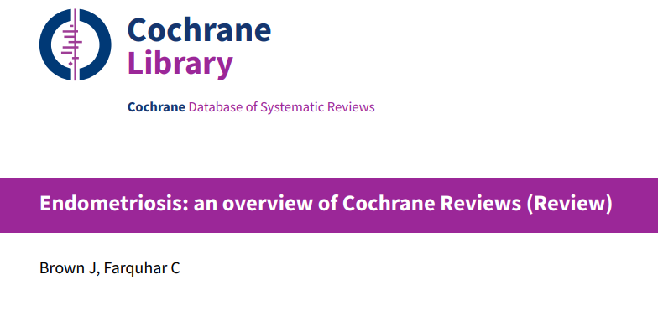
Progestogens
Continuous progestogens and continuous gestrinone are effective therapies for the treatment of painful symptoms associated with endometriosis
Regarding clinical efficacy, progestins are effective in alleviating pain in women with gastrointestinal and rectovaginal endometriosis and have shown result comparable to surgery in the treatment of endometriosis-related dyspareunia
A mechanism that is relevant to endometriosis-related pain is causing the decidualization of ectopic an eutopic endometrium, respectively.

Slide 32
Dienogest
Fourth-generation selective progestin with a direct anti-inflammatory effect
Significant reduction in both diameter and volume of OMA
Ovarian reserve appears to be preserved
Reduced volume by up to 76%
Improved dysmenorrhea by 42.71%
Improved chronic pain by 48.91%
Benefit of progestin use compared to COCs is less thrombotic risk and better tolerability
Improvements to pain associated with rectovaginal endometriosis, bladder endometriosis and DIE

Slide 33
Norethisterone Acetate
Licensed treatment of endometriosis in the USA
Strong progestogenic effect and a androgenic activity
Side-effects include residual androgenic activity (weight gain, acne and seborrhea)
NETA 2.5mg daily – low cost
If tolerated give good symptom control

Slide 34
Levonorgestrel
A systematic review of RCTs comparing the levonorgestrel-releasing intrauterine system (LNG-IUS) with GnRH agonist included five trials with a total of 255 women (Lan, et al., 2013)
In three of the trials reporting on VAS scores, LNG-IUS was found to reduce pain scores, with no difference compared to GnRH agonist (weighted mean difference [WMD] 0.03: 95%CI -0.53 to 0.59).
In a fourth trial, LNG-IUS treatment decreased ASRM staging scores and improved HRQoL similar to GnRH-agonist

Slide 35
Etonogestrel Vs Levonorgestrel
A recent RCT randomised 103 women with endometriosis-associated chronic pelvic pain and/or dysmenorrhea to an etonogestrel-releasing subdermal implant (ENG) or a 52-mg levonorgestrel-releasing intrauterine system (Margatho, et al., 2020).
ENG implant and the LNG-IUS significantly reduced endometriosis-related pain, dysmenorrhea, and chronic pelvic pain

Slide 36
GnRH-agonsits
Regulating the secretion of gonadotropins by the pituitary
Produces an inhibition of the hypophyseal–gonadal axis within 2–4 weeks
Altered lipid profile, depression, hot flushes, and loss of bone mineral density limit their long-term use
Compared to progestins and COCs, GnRH agonists decrease pain symptoms and improve quality of life, however, without inter-group differences

Slide 37
Other hormonal therapies
GnRH antagonists - Alagolic, relugolix, Linzagolix – Suppresions of LH secretion, competitive action on GnRH receptors in endometrial cells – inhibition of growth and proliferation of endometrial tissue
advantage,compared with GnRH agonists, is the dose-dependent effect: in particular, suppression ofpituitary and ovarian hormones is maintained partially at lower doses, while higher doses are associated with full suppression [
SPRMs – Uliptistal acetate, mifepristone and asoprisril – PR modulatros-associated endometrial changes (PAEC) – endometrial antiproliferative effect
Aromatase inhibitors – Letrozole, anastrazole – Blocks conversions of androgens to estrogen -> decreased endometrial proliferations

Slide 38

REFERRING PATIENTS

Slide 39
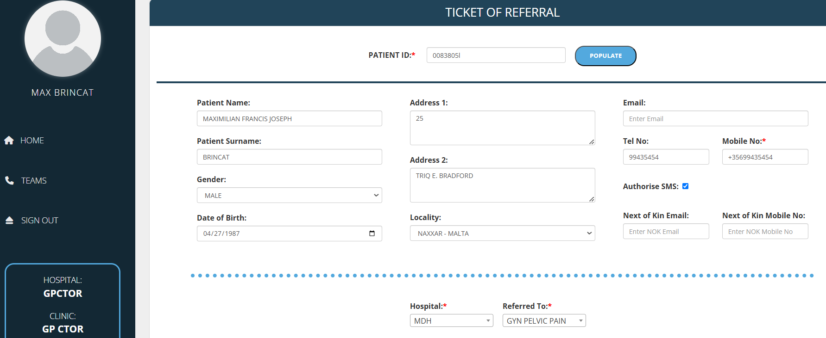

Slide 40
Conclusion
One size does not fit all
Symptom profiling the patient improves outcome
Increasing the imaging sensitivity will provide a better picture without the need for invasive surgical procedures
Hormonal treatment requires further evidence to gain an understanding of mode of action
Progesterone resistance sould be taken into consideration

