Slide 1

Managing Headaches in Primary Care
Dr. Malcolm Vella
Chairman Department of Neurosciences
24th October 2024

Slide 6
History
Age
Onset of headaches
  Longstanding for many years: Benign
  New onset, worsening headaches that disturb sleep: Need investigations
Periodicity of headaches
  Episodic headache: Benign, Migraines
  Chronic nagging headache: Benign, Tension Type Headache
  Clusters: Cluster Headache

Slide 7
History
Type of Headache
  Throbbing and/or worsens with exertion: Migraine
  Pressure and bilateral, like a band: Tension Type
  Shock like, debilitating, severe in a specific distribution of face: Trigeminal Neuralgia
Severity
  Does not always correlate to worrying causes of headache
Associated features
  Aura: Visual, Sensory, Speech, Motor, Vertigo: Migraines
  Autonomic activation: Lacrimation, Blocked nostril, Injected eye: TACs
Triggers
  Alcohol, Sleep deprivation or Oversleeping, Exercise: Migraine
  Eating, talking, touching face: Trigeminal Neuralgia

Slide 8
History
Onset
  Thunderclap Headache: Need to rule out SAH
  Coital Headaches: Need to exclude SAH vs Coital Headaches
Associated features
  Fever
  Systemic Symptoms: Viraemia
  Double vision
  Upper and lower extremity symptoms
  Ataxia
  Personality change

Slide 9
History
Past Medical History
  Malignancy
  Hypertension
Drug History
  Analgesia: type, amount
Social History
  Psychosocial aspect
Systemic enquiry
  Weight loss, cachexia, other symptoms suggestive of malignancy
  Symptoms related to an infective process in cranial region or systemically

Slide 10
Examination
Identifying the sick patient
  Meningism
  Confused/Drowsy patient
Cognitive Examination
Cranial Nerve Examination
  Visual field defect
  Fundoscopy for papilloedema
  Diplopia
  Disorders of extraocular movements

Slide 11
Examination
Upper and Lower Extremity Examination
  Pronator Drift
  Tone: Increased tone
  Power: Focal weakness
  Reflexes: Hypereflexia
  Sensory: Loss or Neglect
  Ataxia: Finger to Nose Dystaxia and Dysdiadochokinesia
Gait: Ataxia, Spasticity

Slide 12
Examination
Upper and Lower Extremity Examination
  Pronator Drift
  Tone: Increased tone
  Power: Focal weakness
  Reflexes: Hypereflexia
  Sensory: Loss or Neglect
  Ataxia: Finger to Nose Dystaxia and Dysdiadochokinesia
Gait: Ataxia, Spasticity

Slide 13
Reaching a Diagnosis

Slide 14
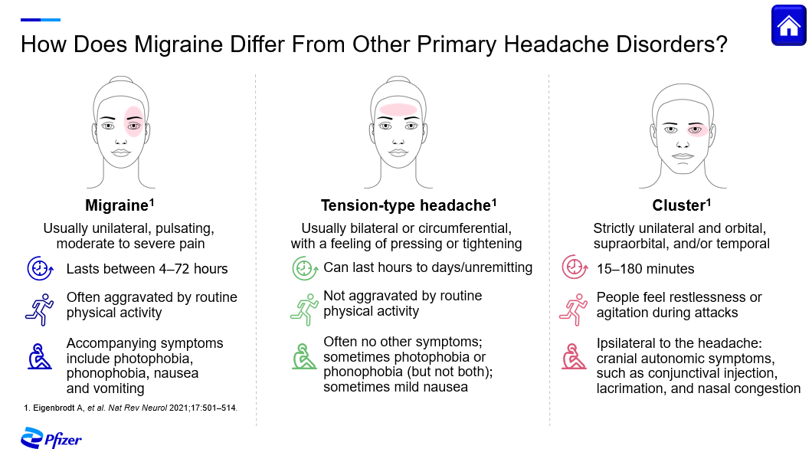

Slide 16
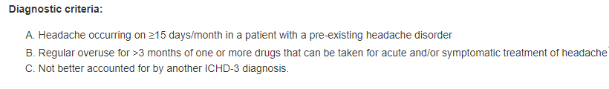
Medication Overuse Headache

Slide 17
Management of Headaches in Primary Care

Slide 18
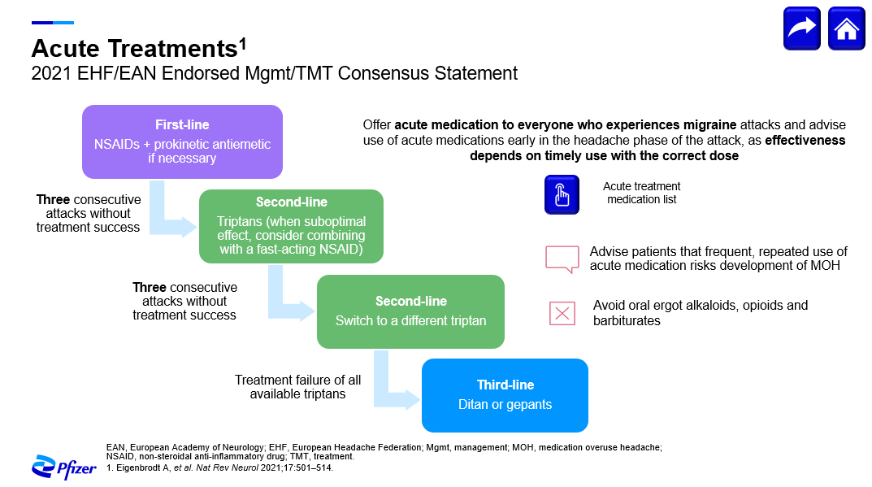

Slide 19
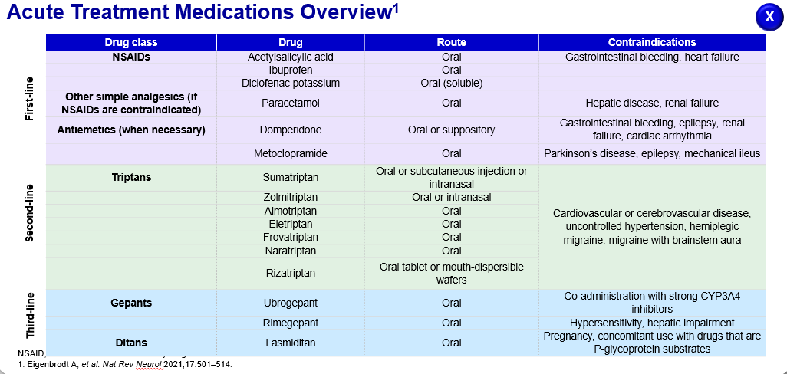

Slide 20
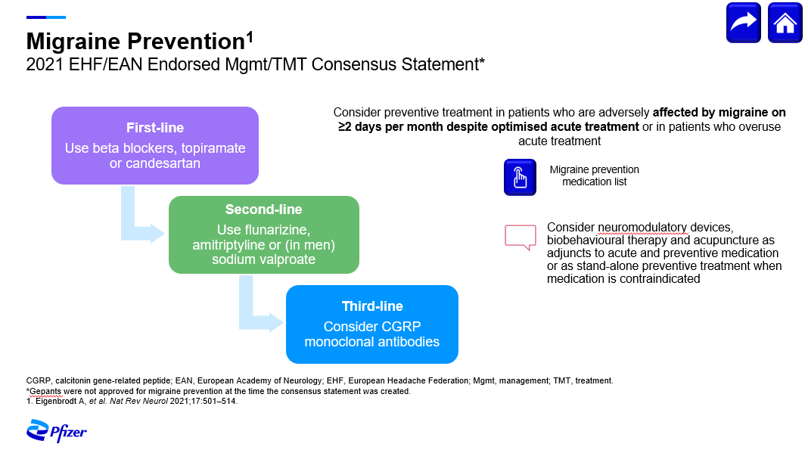

Slide 21
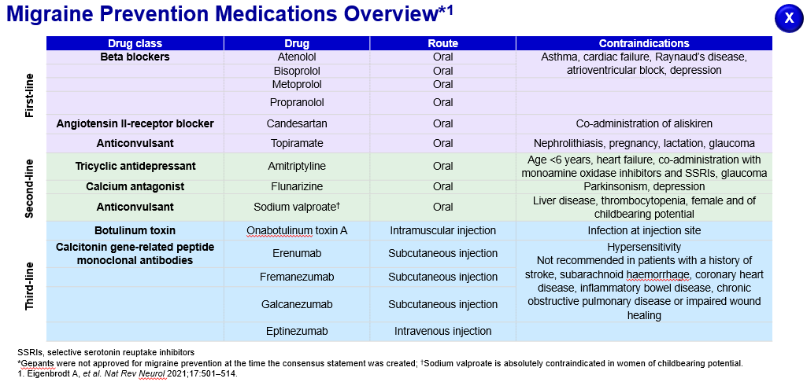

Slide 22
Tension Type Headache
Advice regarding posture
Exercise and relaxation
Massage
Simple Analgesia prn
Amitriptyline for chronic TTH

Slide 23
Cluster Headache
Oxygen and/or Triptans for the acute attacks
Prednisolone
  starting high dose for 5 days then rapid taper in acute Cluster Headache
Verapamil

Slide 24
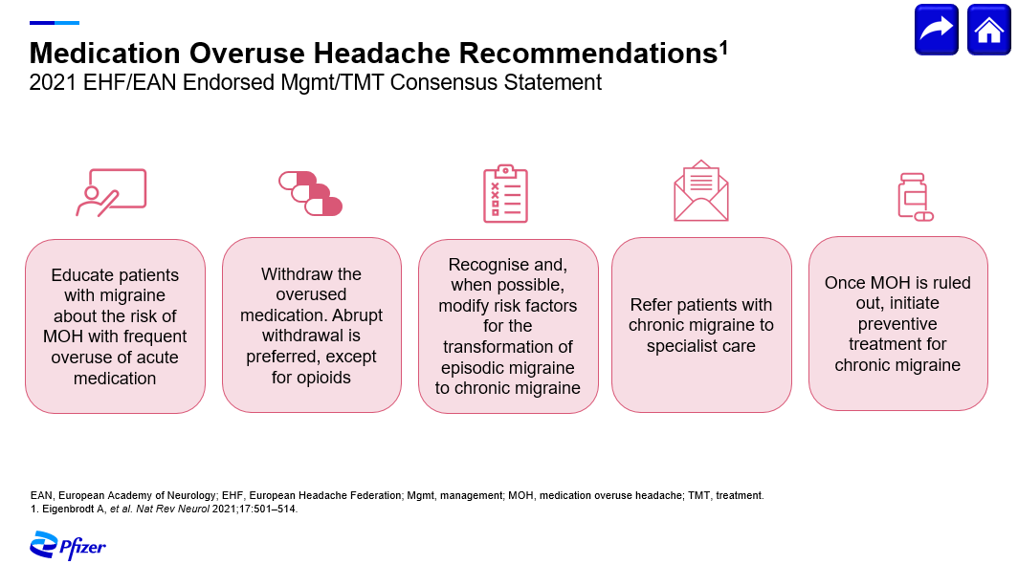

Slide 25
Investigation of Headaches in Primary Care

Slide 26
Investigations
Routine bloods to rule out anaemia, renal failure
ESR and CRP to rule out Temporal Arteritis
Most patients with headaches need ONLY a good history and examination

Slide 27
Follow up patients
Headache patients need follow up
  Supported and Helped
  Look forward to have a follow up and discuss their progress
Headache Diary/Menstruation
Headache scores

Slide 28
Headache Referrals to the Neurology Department
Supervised by :
Dr Maria Bonello (RS Neurology)
Prepared by:
Dr Chirelle Schembri, Dr Gabrielle Grixtri, Dr Nicholas Chong & Dr. Abigail Debrincat

Slide 29
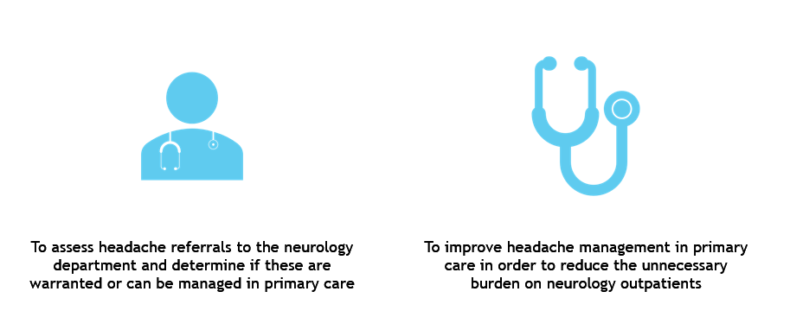
Aim of the Study

Slide 30
Method
Retrospective study, where 629 neurology ticket of referrals were interpreted using CPortal, and those which included headache referrals were then further assessed by accessing the neurology outpatient note on iSoft, investigations and management notes

Slide 31
Results
Total referrals 629
Amount of headache referrals 257
Percentage of headache referrals 40.86%

Slide 32
Results
Percentage of referrals which required imaging including CT/MRI brain: 75/257 = 29%
60/75 = 80% of imaging requested were MRIs
15/75 = 20% of imaging requested were CTs
13/75 = 17.3% had an abnormality found on imaging
  None of these abnormalities where related to the headache presentation
  All Incidental findings
  Pituitary cysts, Microadenoma, Arachnoid Cyst, Small Vessel disease, Cavernomas

Slide 33
Create a new local guideline enlisting criteria when headaches merit neurological referral
Outline management which can be started in primary care setting

Slide 34
When and Where to refer ??

Slide 35
To A&E
Acute Headaches
  All Thunderclap headaches or new onset coital headaches
Headaches associated with a recent personality change
Headaches with new focal neurological signs
Headaches associated with possible CNS infections (sick looking patients)
Headaches in elderly with suspected temporal arteritis and high ESR and CRP
New onset headaches in patients with malignancy (unless they are in close contact with the oncologist/palliative care doctors)

Slide 36
To Neurology Outpatients
Headaches which do not respond to appropriate management for the diagnosis made
Persistent Headaches that do not fit the criteria for TTH, Migraines, MOH
Late onset migraines
New cases of TACs
Facial pain
Please fill up the Ticket of Referrals appropriately with a detailed description of the headaches

Slide 37

Thank You

