Slide 1
PRURITUS ANI & Anal Carcinoma Neville spiteri

Slide 2
Part 1 – pruritus ani
Intense itching around the anus.
Up to 5% of the population, more frequent in men (4:1).
Predominantly 20-40 years of age. Less common in elderly despite more frequent soiling.
Vicious cycle of itching leading to scratching with subsequent skin damage, then further seepage, exacerbating itching.

Slide 3
AETIOLOGY
Idiopathic (primary)
Commonest, but diagnosis after secondary causes have been ruled out
Secondary
Due to underlying condition

Slide 4
 | CAUSE | MECHANISM
ANORECTAL CONDITIONS | RECTAL PROLAPSE HAEMORRHOIDS FISTULA IN ANO ANAL FISSURE SKIN TAGS, MUCOSAL ECTROPION VILLOUS ADENOMA HIDRADENITIS SUPPURATIVA | SEEPAGE OF MUCUS OR STOOL, LEADING TO INADEQUATE CLEANLINESS; PREVENTION OF ANUS FROM CLOSING EFFECTIVELY WITH SECONDARY SEEPAGE
INFECTIONS | STD (HPV, CONDYLOMA, HERPES) NON-STD (TB, FUNGAL, PARASITE) | AN UNDERLYING IRRITATION OR INABILITY TO MAINTAIN PERI-ANAL HYGEINE
ALTERATIONS OF FAECAL CONTINENCE | SURGICAL (COLECTOMY WITH ILEOANAL OR COLOANAL ANASTOMOSIS) TRAUMA (ANAL SPHINCTER DAMAGE) MEDICAL (ANAL SPHINCTER FUNCTION LOSS – CVA, MS, MND) | INCREASED EXPOSURE OF PERIANAL SKIN TO FAECAL MATERIAL AS A RESULT OF POOR SPHINCTER FUNCITON OR ABSENCE OF RECTAL VAULT
PRIMARY SKIN DISORDERS | CONTACT DERMATITIS PSORIASIS ECZEMA, ATOPIC DERMATITIS, SEBORRHOEIC DERMATITIS LICHEN PLANUS/SIMPLEX LICHEN SCLEROSUS LEUKOPLAKIA RADIATION DERMATITIS | CONTACT DERMATITIS DUE TO ALLERGENS IN SOAPS, DETERGENTS, BLEACHES AND PERFUMES
NEOPLASTIC | EXTRAMAMMARY PAGET DISEASE BOWEN DISEASE, INTRAEPITHELIAL NEOPLASIA, PERIANAL NEOPLASMS
DRUGS | ANTI-DEPRESSANTS ACEI ANTIBIOTICS (AMOXICILLIN, TETRACYCLINES, CEPHALOSPORINS) COLCHICINE, DIGOXIN, DIURETICS LAXATIVES CHEMOTHERAPY | DIARRHOEA COMMON DENOMINATOR
SYSTEMIC DISORDERS | DIABETES MELLITUS JAUNDICE URAEMIA LEUKEMIA/LYMPHOMA | DM CAUSES INTERNAL SPHINCTER WEAKENING, DECREASED SENSATION OR FUNGAL OVERGROWTH

Slide 5
diagnosis
Medical History:
Symptoms
Duration and timing
Precipitating factors
Hygiene habits
Chronic diarrhoea
Drug history
Systemic dermatological conditions
STDs
Co-morbidities
Presence of soiling or incontinence

Slide 6
diagnosis
Physical examination
Careful inspection of perianal region
Digital rectal examination
Proctoscopy
Colonoscopy if underlying gastrointestinal issues are suspected
Anal manometry to assess internal sphincter function
Lab
CBC, LFT, Renal profile, Glucose, TFT
Skin swabs to identify infections
Stool tests for parasites
Biopsy in chronic cases

Slide 7
TREATMENT
General Measures:
Gentle cleaning, avoiding irritant soaps
Clothing: Wearing loose, breathable clothing
Diet: Avoiding trigger foods
Maintaining dry, clean anal area
Avoiding scratching
Medical Treatments:
Topical Treatments:
Barrier cream (calamine, zinc oxide)
Steroid – safe and effective in a low dose (hydrocortisone 1%) and for a limited amount of time (<3/52)
Oral Medications: antihistamines for severe itching

Slide 8
TREATMENT of secondary pruritus ani
Anorectal conditions
Causes of seepage/soiling can be corrected by treating with dieatary modifications and medications. If this fails to improve: surgery such as banding of haemorrhoids may be considered. Any faecal incontinence should be treated
Infections
STDs – referred to GU clinic; Pinworm – mebendazole; Fungal infections – treatment of underlying systemic condition, topical antifungal
Dermatologic conditions
Dermatologist input essential; Leukoplakia requires ruling out of neoplasia
Neoplastic causes
The most important step is to recognise neoplastic conditions; any lesions of concern warrant a biopsy

Slide 9
PREVENTION
Hygiene: Regular, gentle cleaning of the anal area
Dietary Adjustments: Identifying and avoiding dietary triggers
Clothing Choices: Wearing cotton underwear, avoiding tight clothing
Regular Clinical Review: If underlying conditions are present

Slide 10
Part 2 – anal carcinoma
Relatively rare – 1.5% of GI malignancies
For treatment to be successful:
timely diagnosis,
accurate staging,
routine surveillance

Slide 11
HIGH-GRADE SQUAMOUS INTRAEPITHELIAL LESIONS
Asymptomatic vs pruritus/burning/pain/bleeding
Untreated HSIL progresses to squamous cell carcinoma in 11% of patients and in up to 50% of patients with extensive disease and immunosuppression
Slow-growing intra-epithelial squamous cell carcinoma
4th to 5th decade
Commonly caused by HPV (6/11/16/18)
Risk factors:
Immunosuppression
HIV
Smoking
Anal intercourse
Vaccination against HPV preventative

Slide 12
HIGH-GRADE SQUAMOUS INTRAEPITHELIAL LESIONS
Diagnosis
Lab
Biopsy of all non-healing perianal lesions is recommended
HSIL appears as discrete, erythematous, scaly plaques
Low and high grade anal intraepithelial neoplasm, based on % of epithelial cells replaced (50% cut-off)

Slide 13
HIGH-GRADE SQUAMOUS INTRAEPITHELIAL LESIONS

Slide 14
HIGH-GRADE SQUAMOUS INTRAEPITHELIAL LESIONS
Management
Mapping of perianal region using full-thickness punch biopsies in quadrantic fashion
Treatment for HSIL: topical trichloroacetic acid/5FU/imiquimod. Modest efficacy
When topical Rx fails: targeted electrocauthery vs WLE

Slide 15
SQUAMOUS CELL CARCINOMA
Symptoms:
Bleeding, discharge, lump, perianal pain
Can easily be misdiagnosed as benign condition (haemorrhoids, fissure)
Due to delayed diagnosis:
up to 90% present with sphincter involvement
30% have lymph node involvement
Examination in suspected cases
External inspection of anus
DRE
Proctoscopy
Lymph nodes

Slide 16
SQUAMOUS CELL CARCINOMA
Patterns of Spread
Spreads locally, mainly cephalad – may appear to have arisen in rectum
Also spreads outwards into the sphincters & rectovaginal septum or scrotum in more advanced cases
Lymph node mets occur frequently.
Initially to perirectal nodes,
Thereafter to inguinal and lateral pelvic nodes
At least 14% present with inguinal node involvement
Only 50% of patients with lymphadenopathy at presentation are found to be due to malingnant involvement (vs reactive)
Haematogenous spread (distant mets) occurs late and usually associated with advanced local disease

Slide 17
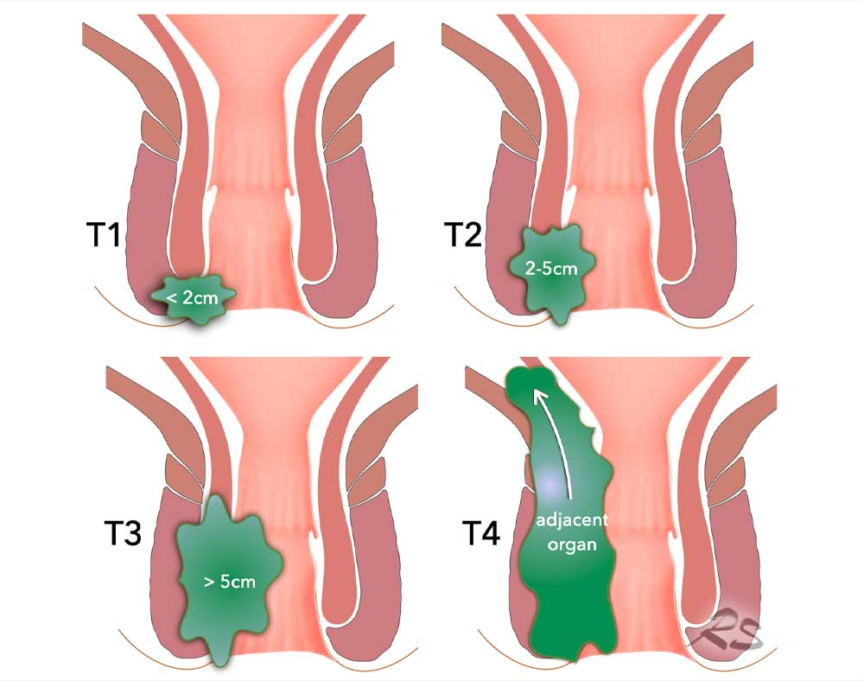
SQUAMOUS CELL CARCINOMA
Diagnosis
Histopathological diagnosis after examination under anaesthesia and quadrantic biopsy
Staging
CT Thorax, Abdomen & Pelvis
MR Pelvis (difficult to interpret lymph nodes)
PET scan for advanced tumour (controversial)
TNM
T1 <2cm,
T2 <5cm,
T3 >5cm,
T4 local invasion
N1: perirectal nodes,
N2: unilateral internal iliac/inguinal nodes,
N3: bilateral iliac/inguinal

Slide 18
SQUAMOUS CELL CARCINOMA
Management
Aim: ablate neoplasm and preserve anal sphincter function
Historically, APR was standard of care, with 40-70% 5 year survival and morbidity of permanent colostomy
1974: Nigro et al – treatment with 30Gy Radiotherapy and concurrent 5-FU & Mitomycin C
Complete response in 70% of cases
5 year survival of 75%
In patients with fistulating disease or incontinence, diverting colostomy before start of chemo-radiation
Repeat MRI 26 weeks after completion of chemoRT.
Salvage APR for patients who fail treatment or have a recurrence
Good overall prognosis (75% 5 year survival) for patients without lymphadenopathy or positive resection margin
Nigro ND, Vaitkevicius VK, Buroker T, Bradley GT, Considine B (1981). "Combined therapy for cancer of the anal canal". Dis. Colon Rectum. 24 (2): 73–5. doi:10.1007/bf02604287

Slide 19
Trial | Inclusion | Design | Treatments | Results
Radiotherapy vs. chemoradiotherapy
UKCCCR Anal Cancer Trial (ACT I) [44,45] | Localized and metastatic, barring exclusion criteria (e.g., previous treatment, cancer at another site, or tumor considered suitable for local excision only [T1 N0]) | 585 patients; 295 in the CRT arm and 290 in the RT-only arm | 45 Gy EBRT and 15 Gy EBRT boost or 25 Gy brachytherapy boost, with vs. without concurrent MMC and 5FU | 42-month follow-up: CRT vs. RT alone locoregional recurrence relative risk 0.54 (95% CI 0.42–0.69, p < 0.0001) Anal cancer-specific mortality relative risk 0.71 (95%CI 0.53–0.95, p = 0.02) 12-year follow-up: for every 100 patients treated with CRT, 25.3 fewer patients experienced locoregional recurrence and 12.5 fewer experienced anal cancer-specific death compared to the RT-only cohort
EORTC [46] | T3-4N0-3 or T1-2N1-3 anal cancer | 110 randomized, 103 eligible, 51 to CRT and 52 to RT alone | 45 Gy EBRT with 15 Gy or 30 Gy EBRT boost with vs. without concurrent 5FU and MMC | 5-year local control greater for CRT vs. RT alone (68 vs. 51%, p = 0.02) 3-year overall survival similar between groups (65 vs. 72%, p = 0.17)
Omission of MMC
RTOG 87-04/ECOG 1289 [48] | Patients with any epidermoid malignancy of the anal canal in which the primary tumor was measurable (any T or N stage) | 310 randomized, 295 eligible, 145 to EBRT + 5FU, 146 EBRT + 5FU + MMC | 45–50.4 Gy EBRT with 5FU with vs. without MMC | MMC associated with greater colostomy-free survival (71% for 5FU and MMC vs. 59% for 5FU alone; p = 0.014) and improved disease-free survival (73% for 5FU and MMC vs. 51% for 5FU alone; p = 0.0003) No OS difference and greater toxicity with MMC
Cisplatin vs. MMC
RTOG 98-11 [7,49] | T2-4NanyM0 (T1 or M1 excluded) | 682 randomized, 649 eligible, 325 to RT + 5FU/MMC and 324 to RT + 5FU/cisplatin | 45 Gy with allowance for 10–14 Gy boost with 5FU + MMC vs. RT + 5FU + cisplatin | 5-year colostomy-free survival improved in MMC arm (72 vs. 65%, p = 0.05); DFS improved in MMC arm (67.8 vs. 57.8%, p = 0.006); OS improved in MMC arm (78.3 vs. 70.7%, p = 0.026)
ACT II [50] | Any T, any N, no distant metastases | 940 randomized, 472 in RT + 5FU/MMC cohort and 468 in RT + 5FU/cisplatin cohort | 50.4 Gy with continuous 5FU, with bolus cisplatin or MMC | 3-year colostomy-free similar (68% in MMC arm, 67% in cisplatin arm, p = 0.94); DFS similar (69% in both arms, p = 0.63); OS similar (79% in MMC arm, 77% in cisplatin arm, p = 0.7)

Slide 20
RT dose escalation vs. de-escalation
RTOG 92-08 [36,48,51] | Any except T1N0 | Single-arm phase II study with 47 patients: standard chemotherapy (5FU/MMC) + high dose RT | 2 weeks of RT, then mandatory gap, total RT dose 59.4 Gy | Median follow-up duration 12 years, estimated 5-year DFS 53%; estimated 5-year colostomy-free survival 58%; estimated 5-year OS 85%
ACCORD-03 [52] | Patients with tumors ≥ 40 mm, or <40 mm and N1-3M0 | 2 × 2 factorial randomization: neoadjuvant chemotherapy and CRT (5FU/cisplatin) +/− high-dose RT; 283 of 307 achieved full treatment | 45 Gy/25 fractions with standard dose boost (15 Gy) vs. high-dose boost (20–25 Gy) with EBRT or brachytherapy | Similar colostomy-free survival (the primary endpoint) for standard vs. escalated boost dose (78 vs. 74%, p = 0.067); nonsignificant improvement in 5-year local control rate for escalated boost dose (83.1%) vs. standard-boost (78.2%)
Intensity-modulated radiotherapy (IMRT)
RTOG 05-29 [53] | T2N0, T3-4N0-3 | Phase II trial evaluating CRT with concurrent 5FU/MMC and dose-painted IMRT | T2N0: 42 Gy elective nodal and 50.4 Gy anal tumor PTVs in 28 fractions T3-4N0-3: 45 Gy elective nodal and 50.4 Gy < 3 cm or 54 Gy > 3 cm metastatic nodal and 54 Gy anal tumor PTVs in 30 fractions | Dose-painted IMRT associated with reduced grade 3+ genitourinary and gastrointestinal toxicity (22 vs. 36%, p = 0.014), and grade 3+ dermatologic toxicity (20 vs. 47%, p < 0.001) when compared to the historical RTOG 98-11 MMC arm

Slide 21
Pencil beam scanning proton beam radiotherapy (PBS-PT)
MGH prospective series [54] | T1-4, N0-3 disease | 25 patients, of whom 23 completed treatment per protocol | PBS-PT per RTOG 0529 dose schema and concurrent 5-FU/MMC | Grade 3+ radiation dermatitis rate 24%; overall rate of clinical complete response was 88%; 2-year local failure rate 12%, colostomy-free survival 72%, progression-free survival 80%, and overall survival 84%
Immunooncology
Multicenter US prospective series [55] | Patients with anal cancer (squamous cell only, adenocarcinoma excluded) and at least one previous systemic therapy for surgically unresectable or metastatic disease | Phase II study of 37 patients with metastatic disease | Nivolumab IV every 2 weeks (3 mg/kg) | Of 37 patients who received at least one dose of nivolumab, 9 (24%) demonstrated tumor response, of whom 2 experienced a complete response

Slide 22
SQUAMOUS CELL CARCINOMA
Surveillance
Patients in complete remission should be evaluated every 3-6 months for a period of 2 years, and every 6-12 months for 5 years, with clinical examination including DRE and palpation of the inguinal lymph nodes
Proctoscopy is an additional option but is sometimes poorly tolerated and too painful following CRT.
Suspicious lesions should be assessed by MRI and/or PET and be biopsied if possible
Annual CT & MRI for 3 years
Very few (<1%) relapses occur after 3 years so extended imaging surveillance after this time is not recommended
ESMO 2021 https://doi.org/10.1016/j.annonc.2021.06.015

Slide 23
Thank you
“…my proctologist is so high tech: he said my examination will be digital…”

