Slide 1
Perianal Abscesses and Fistula
Matthew Sammut
Colorectal Team

Slide 2
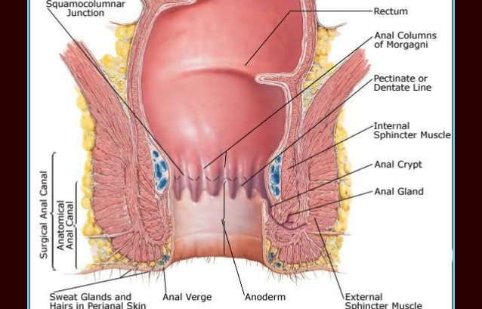

Slide 3
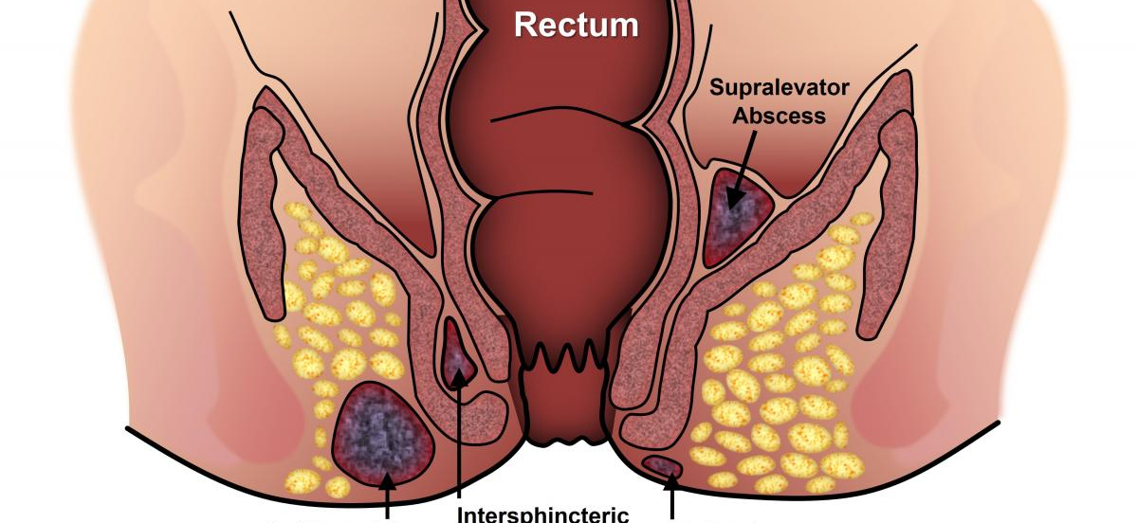
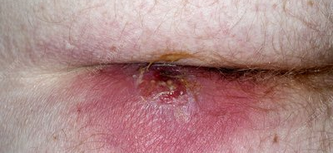
Anal Abscess
Collection of pus at the anal verge

Slide 4
Anal Abscess
Treatment
  Incision and drainage of abscess
  Antibiotics
    Severe erythema
    Diabetes
    Immunosuppression
    Following incision and drainage of an acute perianal abscess, an empiric course of antibiotics is not recommended to prevent fistula development

Slide 5

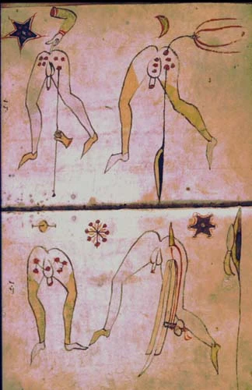
Where we were……
John of Arderne (1307-1392)
Louis XIV
  15th January 1686 – peri-anal pain
  18th January 1686 – spontaneous drainage
  March 1686 – perianal fistula
  18th November 1696 – Operation (M Felix)

Slide 6
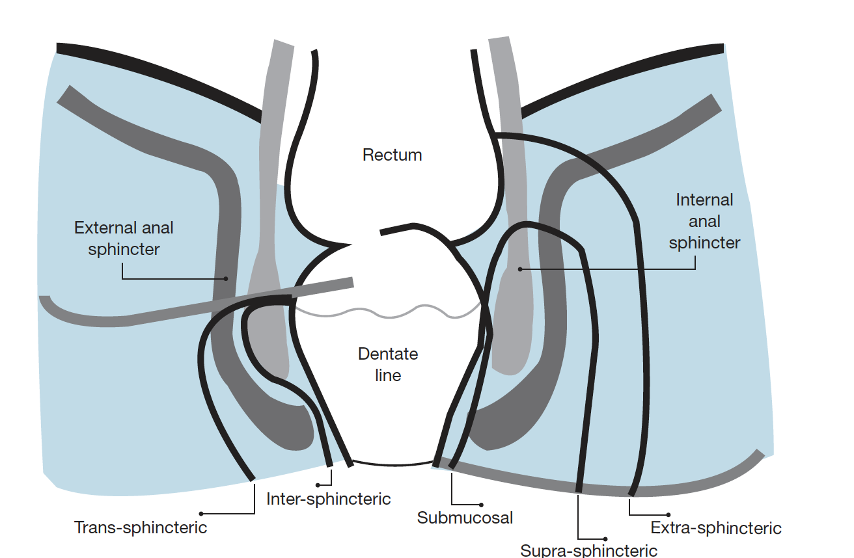
Notes:
Submucosal
Fistula tract passes superficially beneath the submucosa. No involvement of sphincter muscle
Inter-sphincteric
Fistula tract passes through the internal anal sphincter and continues in the inter-sphincteric space to the perianal skin. Tract does not include the external anal sphincter
Trans-sphincteric
Fistula tract passes through the internal anal sphincter and external anal sphincter towards the perianal skin
Low type – less than one third of the distal external anal sphincter is involved
High type – more than one third of the distal external anal sphincter is involved
Supra-sphincteric
Fistula tract crosses the external anal sphincter and internal anal sphincter below the puborectalis muscle
Extra-sphincteric
Fistula tract is external to the anal sphincter complex (passes through the ischiorectal fossa to the perianal skin)

Slide 7
Causes
90% - Crypoglandular Theory
10% - Fissure, Hirandenitis, Pilondial sinus, Crohn’s, trauma, infections, cancer

Slide 8
Crypto-glandular theory
Obstruction of the anal glands located at the dentate line
Infection begins in the space between the internal and external sphincters
Spread through the perianal spaces
Inflammatory tract
Parks AG Pathogenesis and treatment of fistula-in-ano. Br Med J 1961; i: 463–9
Eisenhammer S. The internal anal sphincter and the anorectal abscess. Surg Gynecol Obstet 1956; 103: 501–6.

Slide 9
Will it always happen after Abscess Drainage?
1/3 of patients presenting with an abscess go on to form an anal fistula.
No study identified any associated features that might increase the risk of fistula formation
Lower rate in diabetic patients

Slide 10
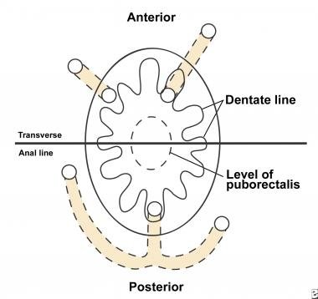
Goodsall’s Law
Goodsall’s rule is more accurate in patients with an opening posterior to the transverse anal line but is less reliable when it is anterior (2,3,4)
Clinical examination 61%
endoanal US 81%
MRI 90%
Rule is for external openings up to 3cm of the anal verge.

Slide 11
Classification
Simple Fistula:
Fistulae involving minimal sphincter muscle and classified as superficial, low-laying trans-sphincteric or low laying inter-sphincteric fistulas.

Slide 12
Classification
Complex fistula :
are those have a high risk of treatment failure and cannot be safely treated by routine fistulotomy for example.
High intersphinteric /transphinteric fistula
Suprasphincteric fistula
Recurrent fistulas
Fistulas with multiple tracts
Fistulas related to inflammatory bowel disease
Fistulas secondary to local radiation treatments
Anterior fistulas in women
Notes:
Fisutlotomy vs fistulectomy
This question has been addressed by one RCT, which
randomized 47 patients to laying open (traditional
fistulotomy) or excision (fistulectomy). Although recurrence
was similar in the two groups, fistulectomy resulted
in a larger wound, with a longer healing time and a higher
rate of continence disturbance.
Kronborg O. To lay open or excise a fistula-in-ano: a
randomized trial. Br J Surg 1985; 72: 970.
* < 30 % of external sphincter muscle (trans sphinteric)
$ < 50% of internal sphincter muscle (inter sphinteric)
There is great variation in the reported results
regarding recurrence (0–21%) [126,127], and incontinence
(0–82%) [126,128].

Slide 13
Classification Dilemma
ESCP
• “Conclusion: There is no consensus which classification system should be used. No consensus, highest level of evidence 3b
• Conclusion: There is no clear definition of simple and complex fistula. No consensus, highest level of evidence 3b”
Notes:
Fisutlotomy vs fistulectomy
This question has been addressed by one RCT, which
randomized 47 patients to laying open (traditional
fistulotomy) or excision (fistulectomy). Although recurrence
was similar in the two groups, fistulectomy resulted
in a larger wound, with a longer healing time and a higher
rate of continence disturbance.
Kronborg O. To lay open or excise a fistula-in-ano: a
randomized trial. Br J Surg 1985; 72: 970.
* < 30 % of external sphincter muscle (trans sphinteric)
$ < 50% of internal sphincter muscle (inter sphinteric)
There is great variation in the reported results
regarding recurrence (0–21%) [126,127], and incontinence
(0–82%) [126,128].

Slide 14

Fistula-in-ano management
4 Key Principles –
Drain sepsis
Eradicate fistula tract
Prevent recurrence
Preserve sphincter function.
Notes:
Fisutlotomy vs fistulectomy
This question has been addressed by one RCT, which
randomized 47 patients to laying open (traditional
fistulotomy) or excision (fistulectomy). Although recurrence
was similar in the two groups, fistulectomy resulted
in a larger wound, with a longer healing time and a higher
rate of continence disturbance.
Kronborg O. To lay open or excise a fistula-in-ano: a
randomized trial. Br J Surg 1985; 72: 970.
* < 30 % of external sphincter muscle (trans sphinteric)
$ < 50% of internal sphincter muscle (inter sphinteric)
There is great variation in the reported results
regarding recurrence (0–21%) [126,127], and incontinence
(0–82%) [126,128].

Slide 15

Fistula management
Primary procedure - aims to control sepsis and maintain drainage of the fistula
Secondary procedure – definitive treatment of fistula tract

Slide 16
Treatment
Low Fistula
  Low fistula
  Less than 1/3 of sphincter involved
Seton
Fistulotomy
Fistulectomy

Slide 17
Setons
Tied loosely over the sphincter to drain the track and allow the sepsis to settle
To divide the sphincter muscle slowly to eradicate the track (cutting seton)
Long term drain

Slide 18
ESCP: Cutting seton – not recommended
“Conclusion: The use of the cutting seton is not advised because of the risk of incontinence. No consensus,
highest level of evidence 2a”

Slide 19
ESCP:
“Conclusion: Loose seton placement is an effective treatment reducing the chance of recurrent abscess formation. Consensus, highest level of evidence 2a
Conclusion: Chronic loose seton drainage is an important alternative treatment for complex perianal fistula. Consensus, highest level of evidence 2a”
ASBGI:
“A loose seton, used as sole treatment, results in fistula healing in only a small proportion of patients. Higher healing rates are achieved by staged fistulotomy after a period of seton drainage. (Level III)”

Slide 20
Fistulotomy:
laying open the fistula from one opening to the other and division of all the anal sphincter below it
identification of all secondary tracks and their adequate drainage

Slide 21
Fistulotomy:
healing in more than 95% of patients.
30% - inadvertent loss of flatus and slight passive soiling, largely determined by internal sphincter division

Slide 22
Treatment
Complex Fistula
  High fistula
  Anterior Fistula
Save the sphincter
Advancement flaps
VAAFT
LIFT
Occulsive

Slide 23
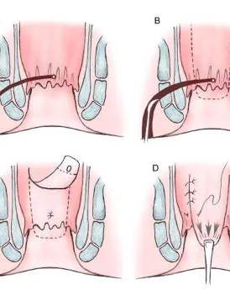
Advancement Flaps
Three main types of flaps
mucosal flap
partial thickness (fibres of the internal anal sphincter are included)
full thickness rectal advancement flaps (includes the entire internal anal sphincter).

Slide 24
Meta-analysis- 2017 % 2019
Significant decrease in mean resting anal pressures (P<0.001)
significant lower mean squeeze pressure after partial thickness rectal advancement flaps.
Higher healing rate
Recurrence rates – 10%- 40%
Incontinence rate – 20.4%
Results:
Lin H, Jin Z, Zhu Y, Diao M, Hu W. Anal fistula plug vs rectal advancement flap for the treatment of complex cryptoglandular anal fistulas: a systematic review and meta-analysis of studies with long-term follow-up. Colorectal Dis. 2019;21(5):502–515. https://doi.org/10.1111/codi.14504
Balciscueta Z, Uribe N, Balciscueta I, Andreu-Ballester JC, García-Granero E. Rectal advancement flap for the treatment of complex cryptoglandular anal fistulas: a systematic review and meta-analysis. Int J Colorectal Dis. 2017;32(5):599–609. https://doi.org/10.1007/s00384-017-2779-7
Notes:
mucosal and partial thickness rectal advancement flaps in high trans-sphincteric fistula-in-ano, the authors noted a significant decrease in mean resting anal pressures in both patient groups (P<0.001) and a significantly lower mean squeeze pressure after partial thickness rectal advancement flaps. The recurrence rate in the partial thickness group was 10% compared to 40% in the mucosal rectal advancement flap group (Khafagy et al, 2010). In a meta-analysis that compared rectal advancement flap surgery to the anal fistula plug procedure, patients who underwent rectal advancement flap surgery showed a significantly higher pooled healing rate (P=0.01) and a significantly lower recurrence rate (P=0.009) compared to the anal fistula plug procedure for complex fistula-in-ano (Lin et al, 2019).
Balciscueta et al (2017) noted in their meta-analysis recurrence rate for rectal advancement flaps was 21%. Mucosal flaps had a recurrence rate of 26.7%, partial thickness flaps had a 22.9% recurrence rate, while full thickness flap recurrence rate was 7.4%. The pooled faecal incontinence rate was 13.3%. Full thickness rectal advancement flaps have a 20.4% patient incontinence rate. However, the significant degree of study heterogeneity makes it difficult to draw conclusions

Slide 25
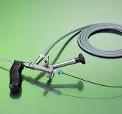
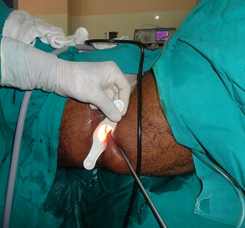
VAAFT

Slide 26
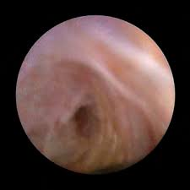
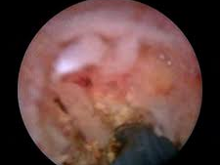
VAAFT
Identification
Cauterisation
Removal of debris within the tracts

Slide 27
Meinero and Mori (2011)
Healing rate of 73.5% (72/98 patients)
No incontinence
No post-operative pain
Other studies:
Recurrance rates – 15.9% - 20%
Success rate – 76%
Complication rate – 16%
No worsening incotenence.
Meinero P, Mori L. Video-assisted anal fistula treatment (VAAFT): a novel sphincter-saving procedure for treating complex anal fistulas. Tech Coloproctol. 2011;15(4):417–422. https://doi.org/10.1007/ s10151-011-0769-2
Jiang H, Liu H, Li Z et al. Video-assisted anal fistula treatment (VAAFT) for complex anal fistula: a preliminary evaluation in China. Med Sci Monit. 2017;23:2065–2071. https://doi. org/10.12659/msm.904055
Garg P, Singh P, Kaur B. Magnetic resonance imaging (MRI): operative findings correlation in 229 fistula-in-ano patients. World J Surg. 2017;41(6):1618–1624. https://doi.org/10.1007/s00268-017-3886-x
Kochhar G, Saha S, Andley M et al. Video-assisted anal fistula treatment (VAAFT). J Soc Laparoendosc Surg. 2014;18(3):121–128. https://doi.org/10.4293/JSLS.2014.00127

Slide 28
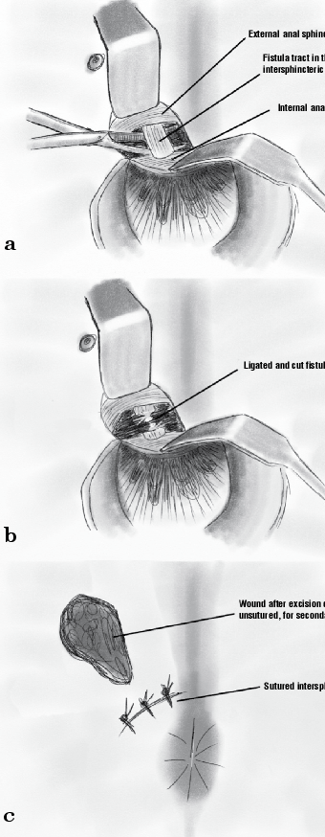
Ligation of the intersphincter tract (LIFT) Procedure
Rojanasakul (2009)
High success rate
low incontinence rates
low postoperative complication rate
minimally invasive procedure
Notes:
low postoperative complication rate 2%

Slide 29
Ligation of the intersphincter tract (LIFT) Procedure
RESULTS
Meta-analysis 2018 and 2019
Pooled weighted success rate – 69% - 78.9% (even after 12 month follow up)
Non healing rate – 17.9% - 19.8%
Studies – no change in incontinence
Alasari S, Kim NK. Overview of anal fistula and systematic review of ligation of the intersphincteric fistula tract (LIFT). Tech Coloproctol. 2014;18(1):13–22. https://doi.org/10.1007/s10151-013-1050-7
Stellingwerf ME, van Praag EM, Tozer PJ, Bemelman WA, Buskens CJ. Systematic review and meta-analysis of endorectal advancement flap and ligation of the intersphincteric fistula tract for cryptoglandular and Crohn’s high perianal fistulas. BJS Open. 2019;3(3):231–241. https://doi. org/10.1002/bjs5.50129
Gendia A, Abd-erRazik MA, Hanna HH. Ligation of the intersphincteric fistula tract procedure and its modifications. J Coloproctol. 2018;38(4):324–336. https://doi.org/10.1016/j.jcol.2018.05.001
Notes:
In a meta-analysis of 13 different studies, the pooled weighted success rate of the ligation of the inter-sphincteric fistula track procedure was reported to be 69%. There was no significant change in weighted success rate (65%) after a 12-month follow-up period. The overall mean non-healing rate was 19.8% (range=0–49%) (Stellingwerf et al, 2019).
The overall healing rates of the pooled data were 78.9% Although only a few studies report incontinence rates, no change in continence has been reported in the literature (Gendia et al, 2018).

Slide 30
Other Options??
Proctectomy
Antibiotics
Radiofrequency
Laser
Surgical Clips

Slide 31
Where we are……

Slide 32
Issues with Studies in Fistula in ano
Heterogeneity of the study population e.g.
- Length of follow up
- Different end points
- Fistula site and number of fistula tracts
- Case mix e.g IBD vs Non IBD
Small study numbers
A reliance on cohort studies rather than RCTs
Operator dependant interventions.
Bias in reporting of novel techniques.

Slide 33
Conclusion
Perplexing topic
Which treatment is the gold – standard to compare it to?

