Slide 1

Management of Common Peri-Anal Conditions
Fissures and Haemorrhoids Mr. Charles Cini
Abscesses and Fistulas Mr. Matthew Sammut
Pruritus Ani and Anal Cancer Mr. Neville Spiteri
Panel Discussion All speakers

Slide 2
Fissures and Haemorrhoids
Mr. Charles Cini MD., MRCS. FEBS Gen Surg. FRCS Edin Gen Surg.
Consultant General and Lower GI Surgery

Slide 3
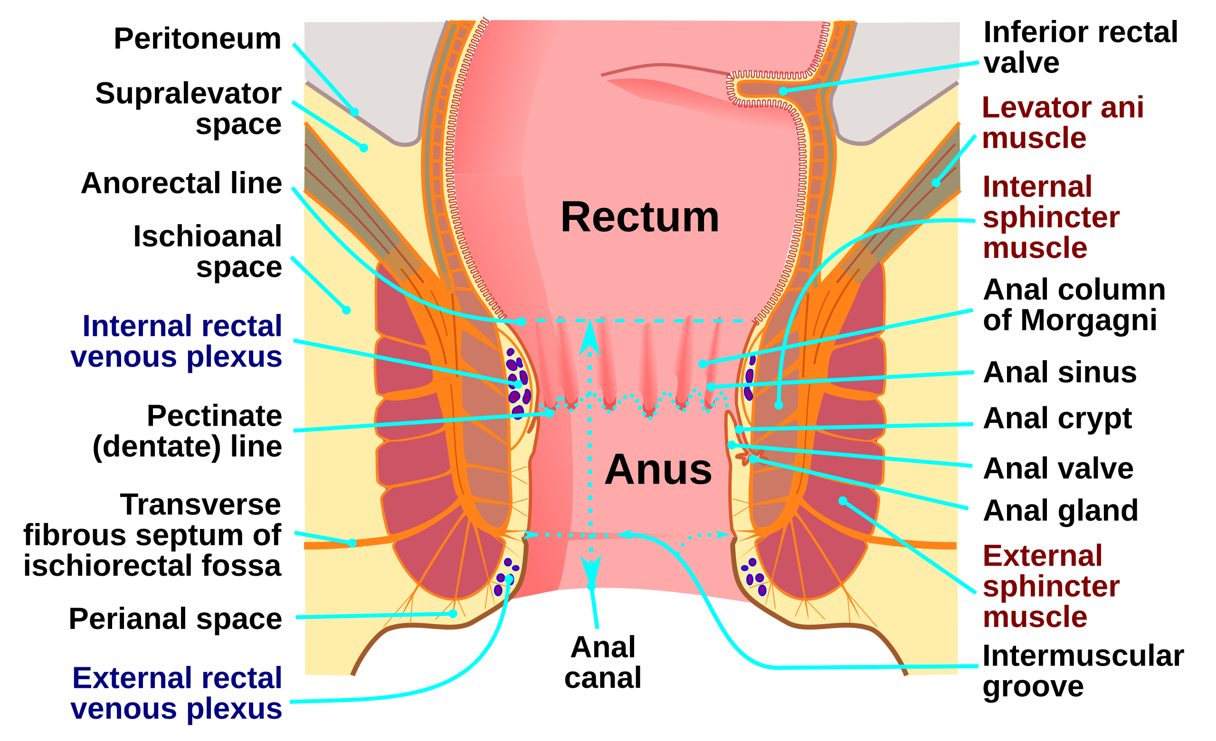
Anal Canal Anatomy

Slide 4
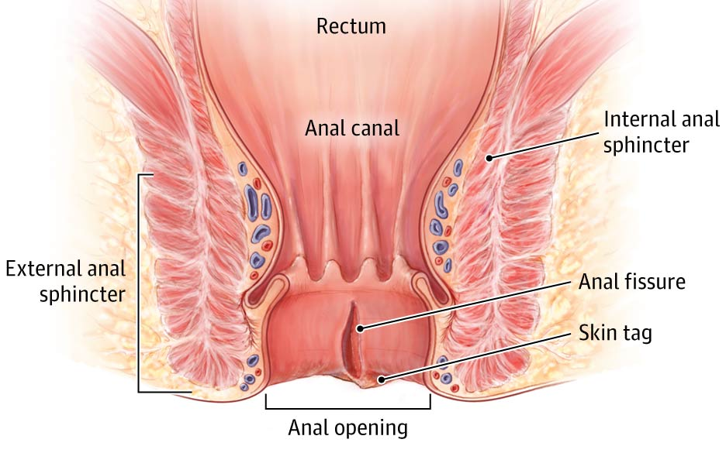
Fissure in ano
Definition:
An anal fissure is a longitudinal tear along the sensitive epithelium of the distal anal canal.

Slide 5
Acute vs Chronic
Acute fissure
    Looks like simple tear in anoderm
    Symptoms started less than 6 weeks ago
Chronic fissure
    Present for a longer duration than 6 weeks
    There is a distal sentinel pile
    There is a proximal hypertrophied papilla
    Internal anal sphincter muscles fibres can be seen at base of fissure
90% of fissures are located in the posterior midline.
In females up to 25% are found in anterior midline.

Slide 6
Aetiology
The passage of a large, hard stool is the commonest cause.
Can be caused by trauma and chronic diarrhoea.
Manometric studies have shown an elevated resting pressure in patients with fissure.
Anatomically the ano rectal angle tends to place the maximum stress in posterior midline.
Anal canal area has poor blood supply and is susceptible to ischemia.
Anterior fissures are associated with history of obstetric damage.
Fissures that are away from midline associated with other pathology;
  Crohn’s disease
  Anal Carcinoma
  Infections - Tuberculosis, Syphilis,
  HIV, HPV

Slide 7
Symptoms
Severe pain during and after defecation is the most common symptom.
Patients can usually recall the index event
Pain typically lasts several hours
Fresh blood described as a streak on the the surface of the stool or as a line on the tissue paper is typical.
Anal spasms that last hours after defecation

Slide 8
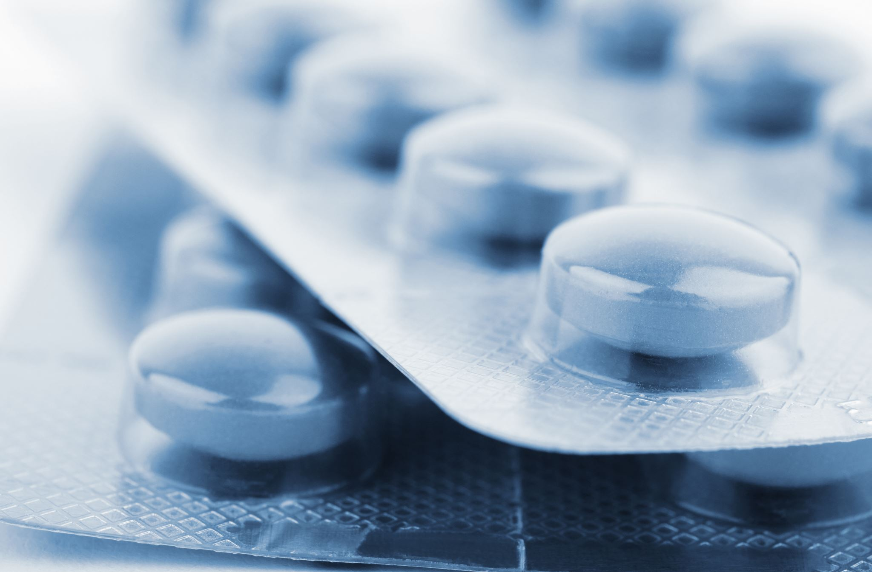
Treatment
Acute fissures
- Conservative measures
      Reassurance
      Adequate hydration
      High fibre diet (aim 20 to 30g of fibre daily)
      Stool Softeners
      Sitz baths twice daily
      Topical anti-inflammatory creams
      Analgesia
Conservative measures heal approximately 50% of acute fissures

Slide 9
Treatment
Conservative measures only help in 35% of chronic fissures
Topical nifedipine or nitroglycerine heal about 48.9% of chronic fissure. (Nelson et al 2012)
Botulinum toxin relaxes the sphincter for 2-4 months. It is more effective than GTN
Botox only heals 45% of refractory fissures compared to 92% healing following LAS (Arroyo et al 2005)
Botox may be an option in patients in whom continence may be an issue.

Slide 10
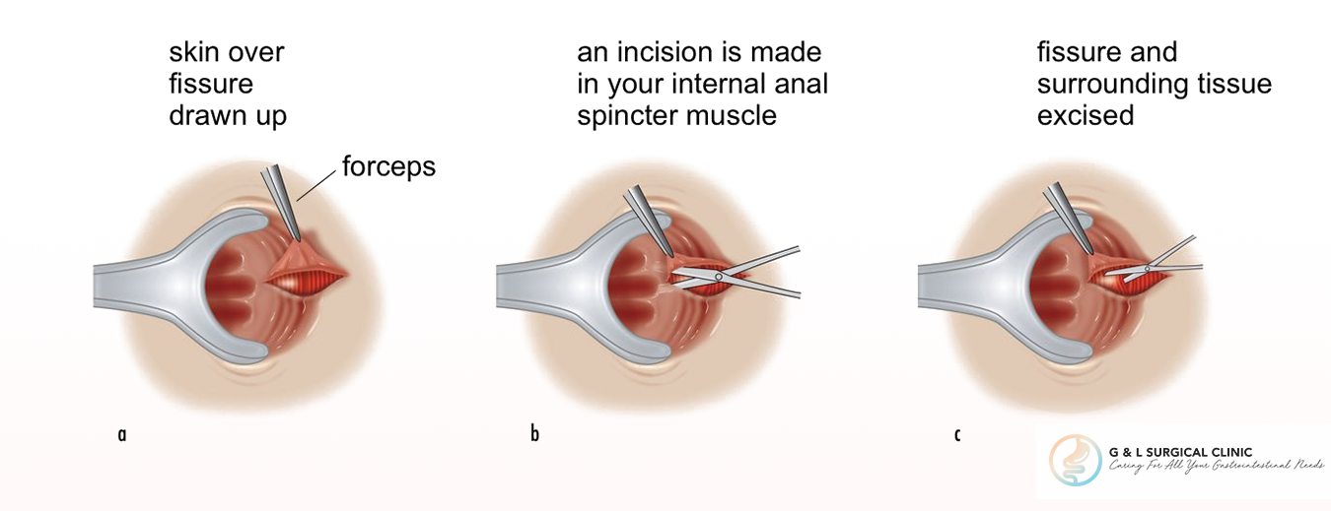
Lateral Internal Sphincterotomy
Can heal 88-100% of fissures
Can be done as open or closed procedure
The midline is avoided due to the risk of keyhole deformity of the anus
Only the lower part of the internal sphincter is divided
This procedure carries an inherent risk of incontinence to stool, gas or soiling (Nelson et al 2011)

Slide 11
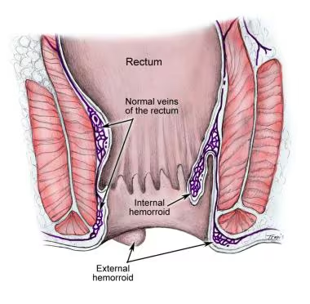
Haemorrhoids
Normal human anal canal has vascular cushions that contribute to 20% of normal resting pressure
Anal cushions are typically located in the 3 o’clock, 7 o’clock and 11 o’clock positions.
Internal haemorrhoids develop above the dentate line and are covered with anoderm
External haemorrhoids develop below the dentate line and are covered in skin
Mixed haemorrhoids made up of haemorrhoids extending from internal to external territory

Slide 12
Aetiology
Increased abdominal pressure
    Constipation and diarrhoea
    Pregnancy and delivery
    Chronic obstructive airway disease
Increased portal venous pressure in liver disease and in porto-systemic shunts
Increased pressure results in dilation of the hemorrhoidal plexus, distention and eventual prolapse.
4.4% of the population get symptomatic haemorrhoidal disease

Slide 13

Internal Haemorrhoids - Symptoms
Rectal Bleeding – fresh blood
Anal bulge and pressure
Pain and tenesmus
Mucous discharge
Itching
Difficulty with daily hygiene

Slide 14
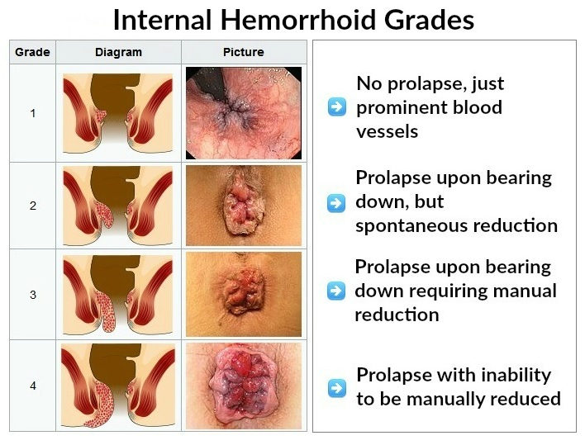

Slide 15
External/Mixed haemorrhoids Symptoms
Severe pain after straining at stools or heavy exertion
One or more bulges underneath the anal skin
Fresh blood in toilet bowl, on paper or on stool
Thrombosis leading to a hard and painful peri-anal lump
Skin tags in the long term

Slide 16

Medical Management
Lifestyle modification – high fibre, high fluid intake and exercise
Avoid sitting on toilet for a long time
Stool softeners
Soothing topical haemorrhoidal creams
Steroid based creams
Vein constrictors
Analgesia
Thrombosed haemorrhoids may benefit from drainage if seen within 48 hrs of onset

Slide 17
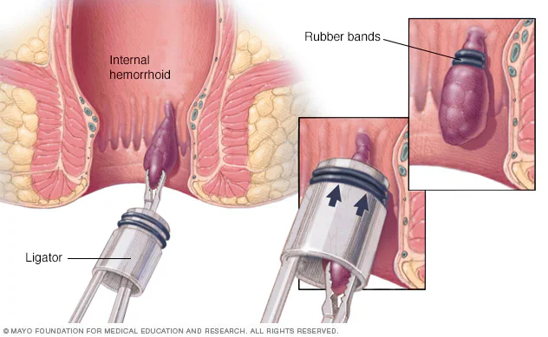
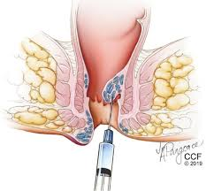
Rubber Band Ligation and Sclerotherapy

Slide 18

Other Office based procedures
Infrared photocoagulation
Bipolar diathermy
Direct current electrical therapy
HET Bipolar System
Laser

Slide 19
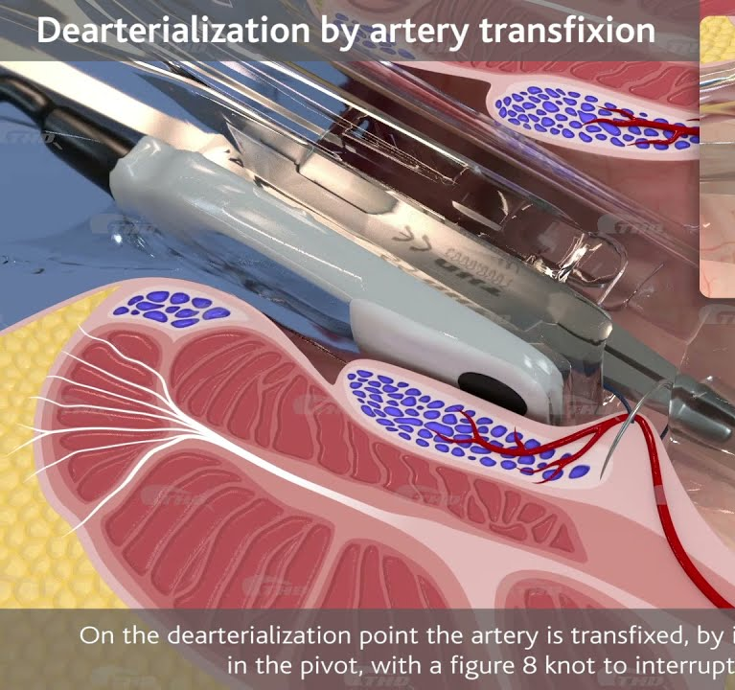
Transanal Haemorrhoidal Dearterialization
Doppler guided ligation of arteries
Grade 2 and 3 haemorrhoids
6 arteries, 2 in each position typically ligated
Recto-anal repair by performing a muco-pexy helps reduce prolapse

Slide 20
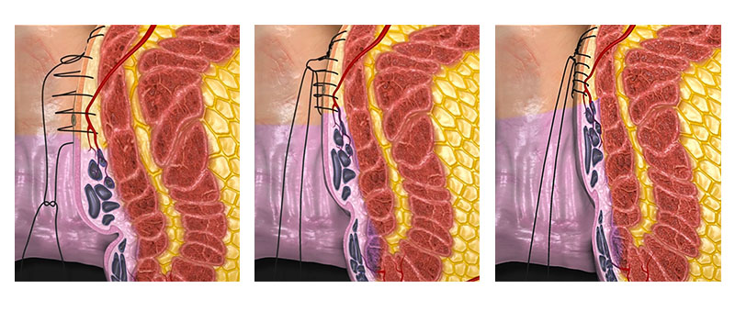
Haemorrhoidopexy

Slide 21

Surgery cont….
Ferguson’s Haemorrhoidectomy
Described in 1971, similar to Milligan Morgan but wounds are closed
Whitehead Haemorrhoidectomy
Circumferential haemorrhoidectomy
Suitable for circumferential haemorrhoids
A 360 degree sleeve is excised
Associated with high rate of anal canal stenosis and incontinence
Stapled Haemorrhoidectomy (Longo procedure)
Described in 1998, utilizes a specifical designed circular stapler
Excises a sleeve of mucosa including haemorrhoids, transecting arterial supply in the process

Slide 22
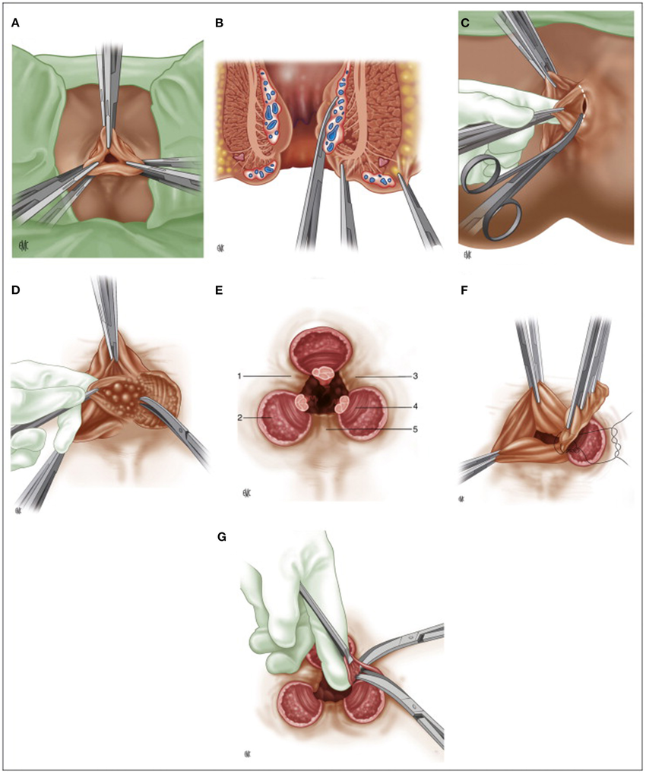
Milligan Morgan Haemorrhoidectomy
Described in 1937
General or regional anaesthesia
Haemorrhoids in 3, 7 and 11 o’clock dissected off sphincters.
Pedicle ligated with absorbable suture
Bridges preserved and wounds left open

Slide 23
Haemorrhoids in Special Situations
Immunocompromised patients
    Conservative treatment
    Risk of sepsis and impaired wound healing
Portal hypertension
    Diagnosed at flexible sigmoidoscopy
    Banding associated with delayed severe bleeding
    Conservative/ radiological embolization
Pregnancy
    25-35% of pregnant women develop symptoms, most common in 3rd trimester
    Increased blood volume, decreased venous return, constipation and labour strain
    Conservative unless acute thrombosis, most symptoms resolve postpartum

Slide 24

Thank you

