Slide 1
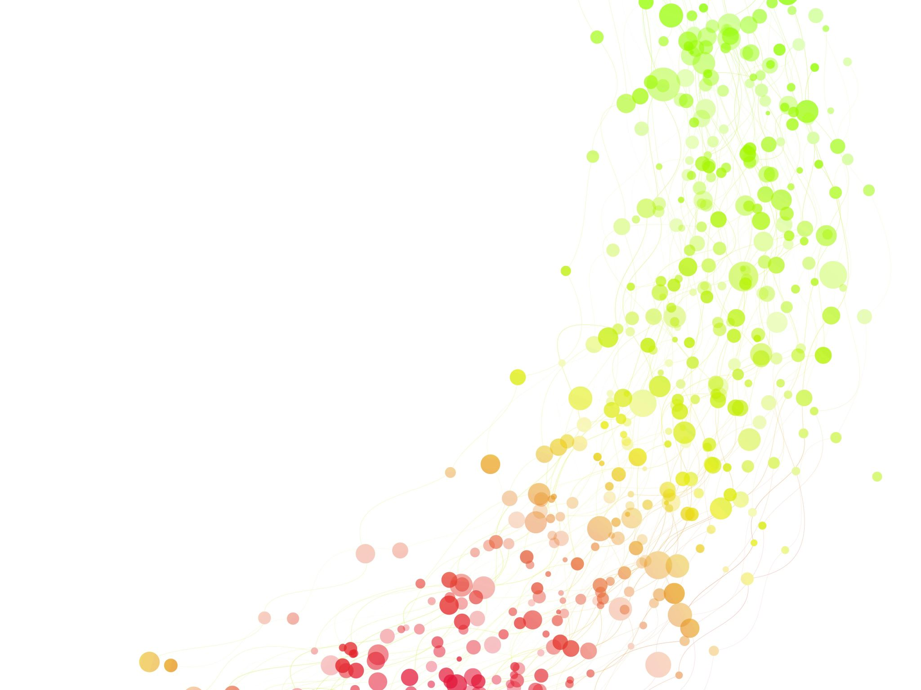
Rheumatology – a Podiatrist’s perspective
Danine Bartolo
Higher Podiatry Practitioner

Slide 2
Rheumatology- management of rheumatic diseases and painful and functional disorders of the musculoskeletal system. – over 200 conditions.
Most common cause of work limitation and work absence worldwide.
UK- 20 million people suffer from a rheumatic disease at some point in their life.
Conditions related to rheumatic conditions form 20-25% of the GP’s workload.
Increasingly older population this is set to increase.
Foot involvement in RA, Spondyloarthropathies, Connective tissue diseases and OA is substantial with a wide range of articular and extra-articular involvement.
Notes:
The Foot 33 joints, 26 bones, and more than a hundred muscles

Slide 3
The podiatrist’s role
Examine, diagnose and treat foot problems
Pain management
Joint protection
Gait analysis
Biomechanical examination
Orthoses
Advice on safe self care- devices and aids
Advice on footwear most suitable for particular foot condition/ biomechanical problem.
Prevention and treatment of ulceration especially on bony prominences
Advice on exercises – stretching, strengthening

Slide 4
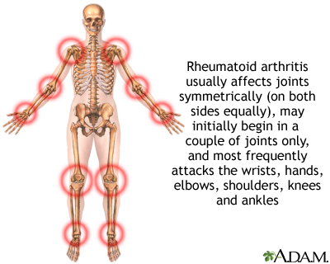
Inflammatory arthritis - Joint damage is the main concern
Multitude of joints, soft tissue structures with a synovial lining in the foot.
Joint damage and loss of function in RA occur early in the disease process.
Occurs mostly in mpjs and ankle joint.

Slide 5
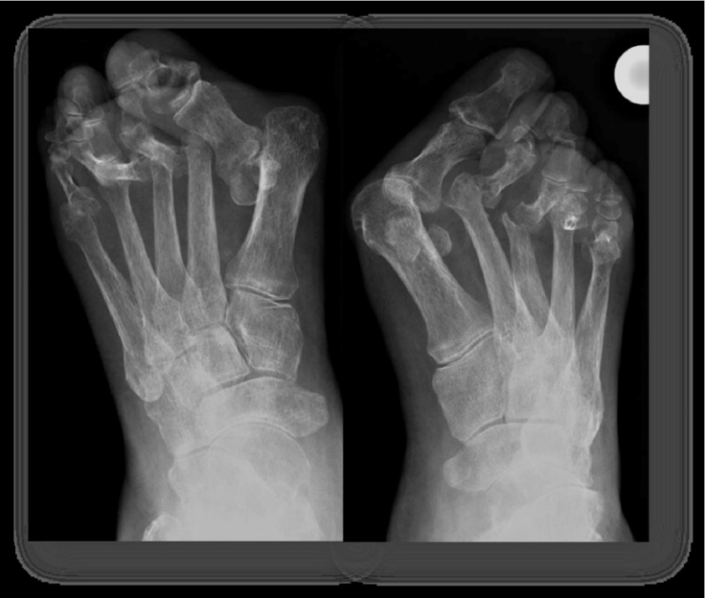
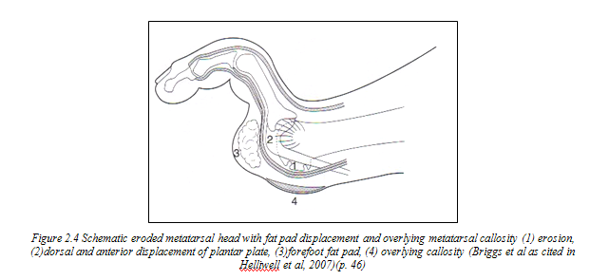
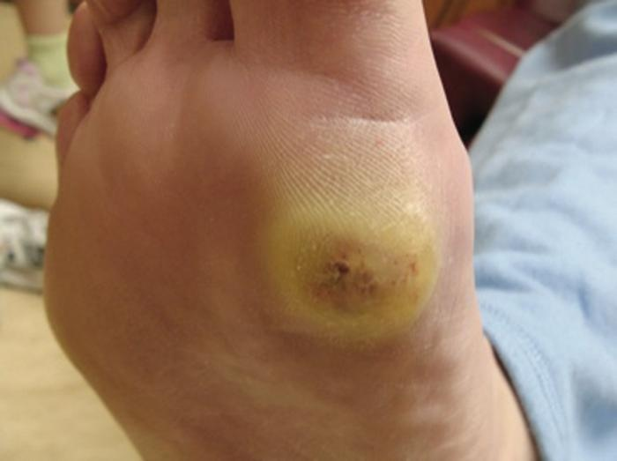
The foot in RA -Deformities
Notes:
With synovial inflammation of the joints- Weakening of the intra articular and periarticular joint structures
laxity and distension of the joint capsule and surrounding ligaments, plantarplate laxity resulting in dislocation and subluxation of the joints.
Prominent MPJ- ( Areas of high pressure ) and over-riding and under- riding toes.
Ligaments surrounding the ankle and STJ along with abnormal mechanics lead to pesplano valgus
Obviously with improved pharmacological treatment the severity of deformities has reduced

Slide 6
The foot in RA- how can we help?
Early RA- Insoles to correct biomechanical problems and help reduce progression of deformities. – functional / semi functional orthotics.
Silicone devices and exercises to reduce progression of deformity.
Later stages limited joint movement and structural deformity is present -Accommodative orthotics are normally advised.
Reduction of pressure and reducing possibility of ulceration
Mouldable silicone would be ideal in case where toe deformities are multiple
Advise on Footwear and over the counter devices / aids.
Notes:
Joint loading is an important factor in deformity progression when there is synovitis.
Early stages when movement is still quite normal we try to reduce joint loading by reducing mechanical abnormalities and abnormal forces on joints

Slide 7
The foot in RA
Treatment of Foot ulceration - Due to the inflammatory process, structural changes and potent immunosuppressants ulcers take much longer to heal.
PAD screening Patients with Rheumatoid arthritis found to have an increased risk of atherosclerosis Caraba et al, 2020 and arteriosclerosis.
Neuropathy screening – 10g monofilament & tuning fork
Routine care - high level of immunosuppression classifies the patient as a high risk patient.
Advice and Patient Education - Good footcare practices can reduce complications

Slide 8
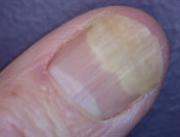
Psoriatic arthritis and the Foot
PsA affects the ankle and toes in 40- 50% of patients.
Forefoot deformities (hammer toes, OA changes in IPJ, sausage toes, HAV)-
Rearfoot deformities (pes plano valgus)
Enthesopathy is common- Achilles tendinopathy, Posterior Tibial tendinopathy, Plantar Fascitis
Nail changes -pitting, lyses, Differential diagnoses from mycosis by sampling and laboratory testing

Slide 9
PSA – Our Role
Orthotics and Insoles – Biomechanical problems
Silicone appliances
Insoles to reduce strain on tendon – enthesopathy,
Taping, Footwear advise
Routine care- patients on immunosuppressants

Slide 10
Connective tissue Disorders
Systemic sclerosis
Decreased Rom in joints – insoles , footwear. Foot excercises
Ulceration- treatment , pressure reduction
Peripheral arterial disease- doppler analysis
Routine care
Lupus
Pain in the foot mainly due to altered biomechanics
Neuropathy and peripheral circulatory problems may arise
Routine care

Slide 11
Fibromyalgia and Hypermobility
Fibromyalgia
Lower limb pain due to biomechanical problems
Patients may require advise on footwear for more comfort. Different patients may need different requirements.
Insoles- consideration of different material properties to provide more comfort whilst offering functional control.

Slide 12
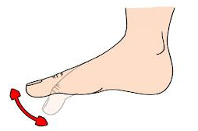
Hypermobility
Biomechanical foot problems- increased injury, tendinopathies and biomechanical pain.
Advise on footwear.
Strengthening exercises of foot muscles.
Exercises to help in proprioception.
Hypermobility Syndromes
Toe deformities
Increased Ulceration
Unstable Gait

Slide 13
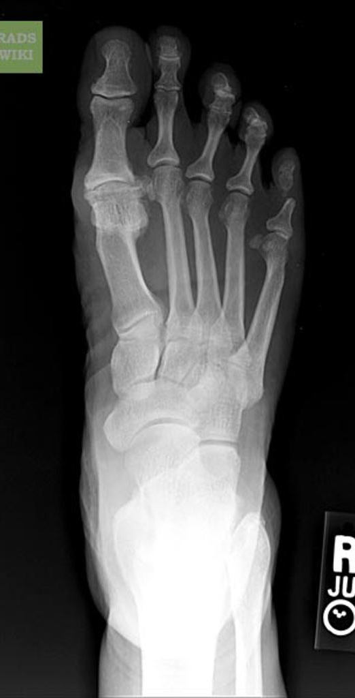
Osteoarthritis
Hallux rigidus (1st MPJ OA)
Orthotics and modifications in orthotics can help in different stages of the different conditions.
Advise on footwear.
Midfoot OA and Ankle OA
Footwear advise and insoles if needed.

Slide 14
Osteoporosis
We think of fractures in spine and hip but not the ones related to the feet…!
The feet carry all the body weight as, the spine degenerates, foot posture and pressure is altered leading to compensatory mechanisms that can lead to fractures (Cindric, 2011)
Bone density status considered- orthoses, footwear advise/ properties and advise on exercise

Slide 15
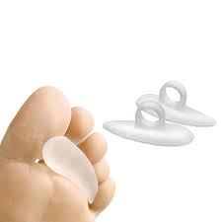
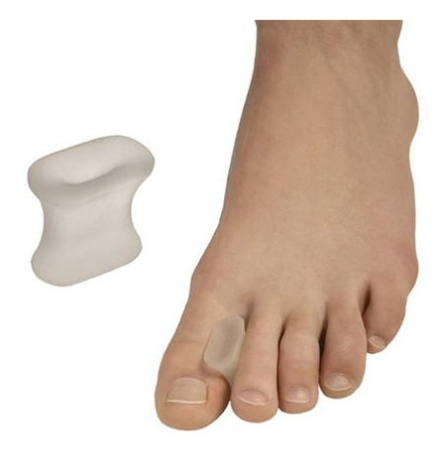
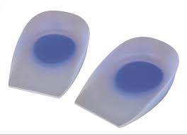
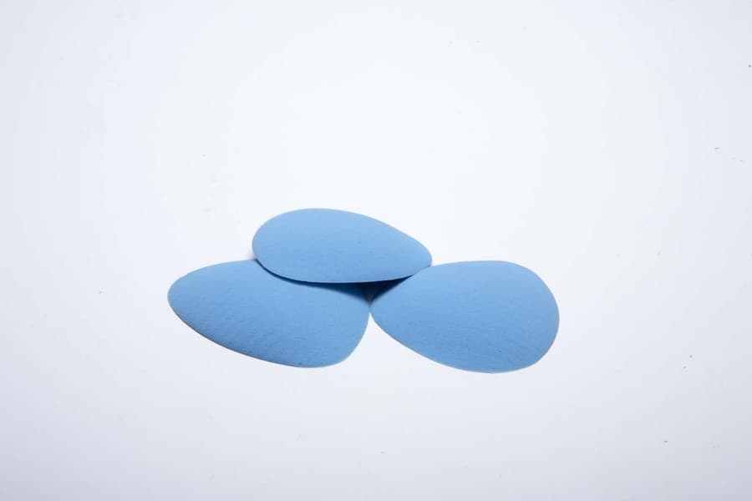
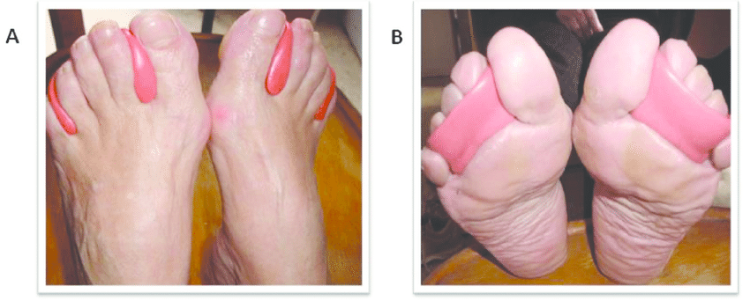
Appliances

Slide 16
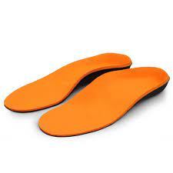
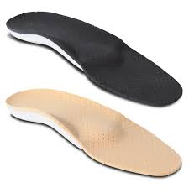
Orthotics
There are many types of Orthotics
Accommodative , Functional, Semi- Functional.
Over the Counter
Prefabricated
Fully Customized
Adaptations to insoles
Notes:
Pre fabricated which can be moulded to the patient’s need
Different materials plastics, carbon fibre, EVA, foams –even for the different parts of the insoles . These vary according to the patients biomechanical needs and the patients medical conditions eg OA in spine or generalized, , Fibromyalgia do not tolerate certain materials
Flare up in RA different materials
Osteoporosis – use different materials even if Good Range of motion is present
Hypermobiltiy deeper heel cup would be needed for better control

Slide 17
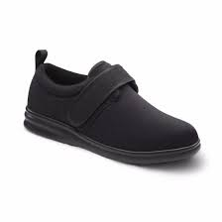
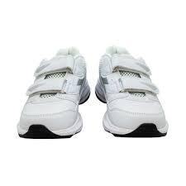
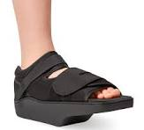
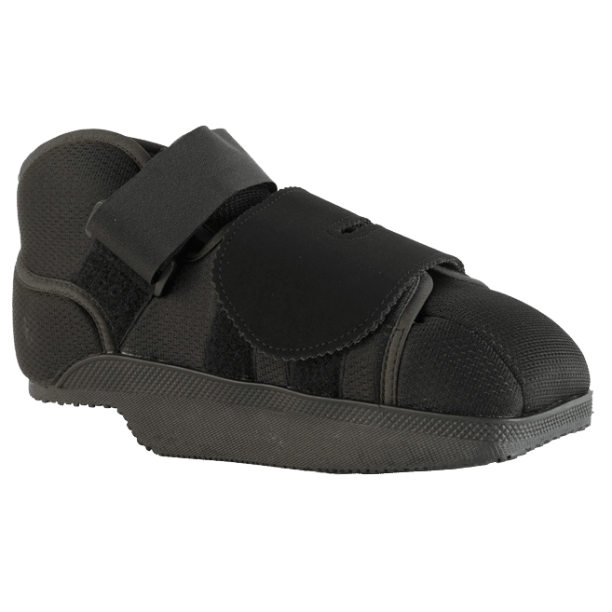
Footwear
Notes:
Advise on Footwear according to the patient’s need. Some may need a stiffer outsole ( hallux rigidus) others a more flexible one . Material may vary ex patients with fibromyalgia may not tolerate a harder material for the upper . We may need shoes for offloading a particular area eg in ulceration

Slide 18
Podiatry Rheumatology Services
Two Podiatrists working within the rheumatology team.
B’Kara Health Centre - clinic held three times weekly including one of which is a new case clinic.
MDH – Afternoon joint clinic with a rheumatology consultant.
Participate in weekly interdisciplinary meetings and in journal clubs.
Referral – GPs and Health Professionals can refer patients to the clinic by sending us an email on podra@gov.mt. Important that referral is detailed including name of medications being taken.

Slide 19
References
Caraba, A ., Iurciuc ,S & Iurciuc., M ( 2020) in Vascular involvement in Reem HamdyA., M ( eds) in Rheumatoid arthritis in Rheumatoid Arthritis.
Gunter S, Robinson C, Woodiwiss AJ, et al. (2018) Arterial wave reflection and subclinical atherosclerosis in rheumatoid arthritisClin Exp Rheumatol 2018;36:412–420.

