Slide 1
Podopaediatrics Centre of Excellence B’kara Health Centre
Mr. Ivan Farrugia
DPod SR Pod MPodA MSc Glasgow
Podiatrist

Slide 2
Career overview
1998 - Graduated UOM – Diploma in Podiatry
2006 – President APM – 2 years
2006 – Clinical Educator
2008 - PGCert – Podopaediatrics (GCU UK)
2012 – MSc – Podiatry (Podopaediatrics) GCU UK
2012 – Opening Podopaediatrics B’Kara COE
2013 – Lecturer UOM - Podopaediatrics Module
2018 – President APM – till today
2020 – Vice President FIP – 2 years
2021 – Executive Allied Health Care Practitioner
2022 – President FIP – 2 years

Slide 3
Podopaediatric clinic
Service was introduced in February 2012
Aims:
To educate and to deal with conditions according to evidence based literature
To reassure parents/guardians on several foot and ankle conditions that could be part of the normal child growth development
To work hand in hand with other Health care professions in the Paediatric arena

Slide 4
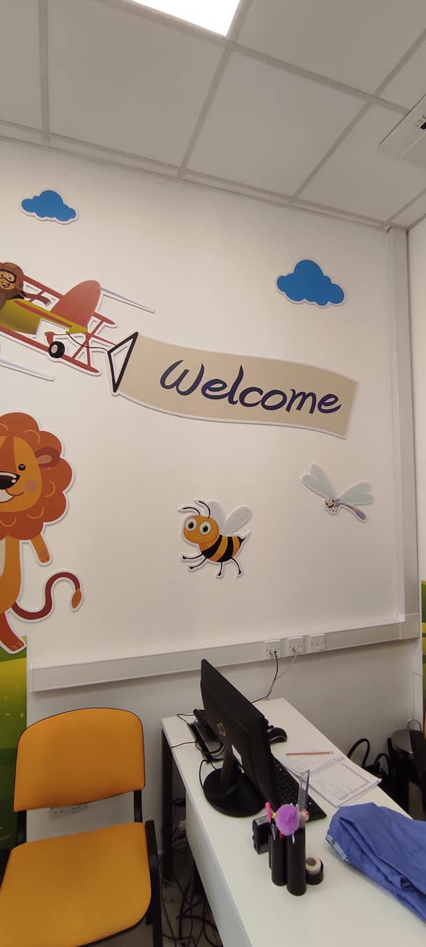
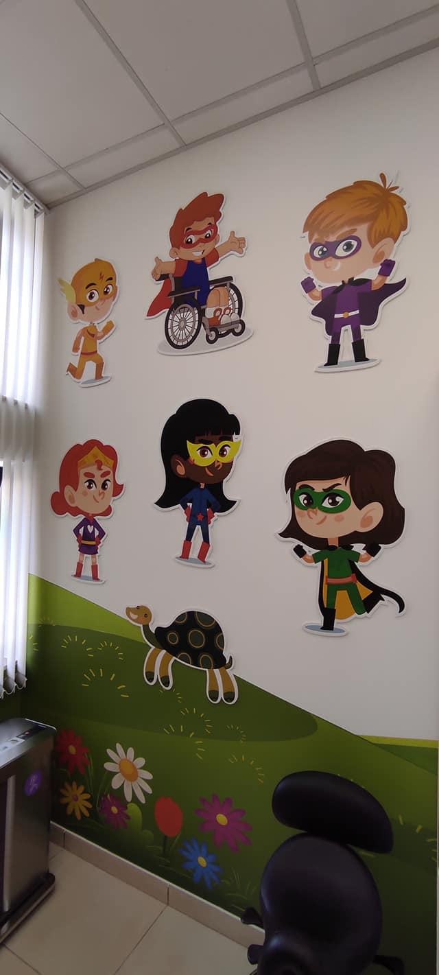
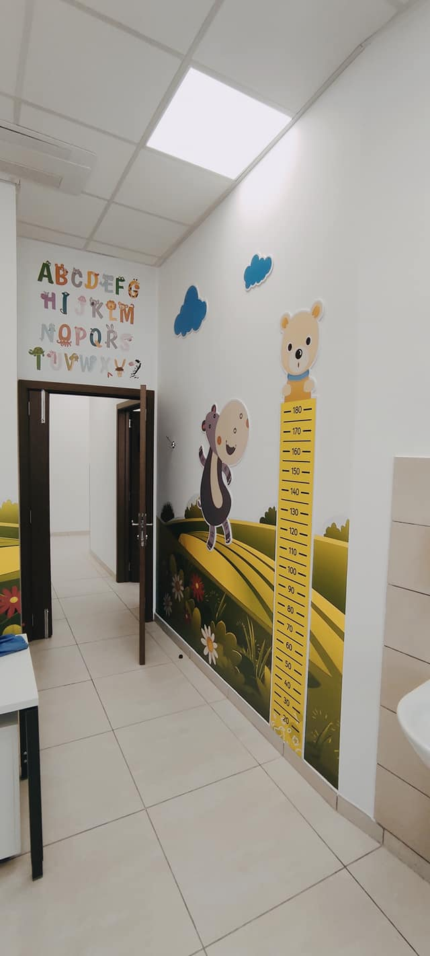
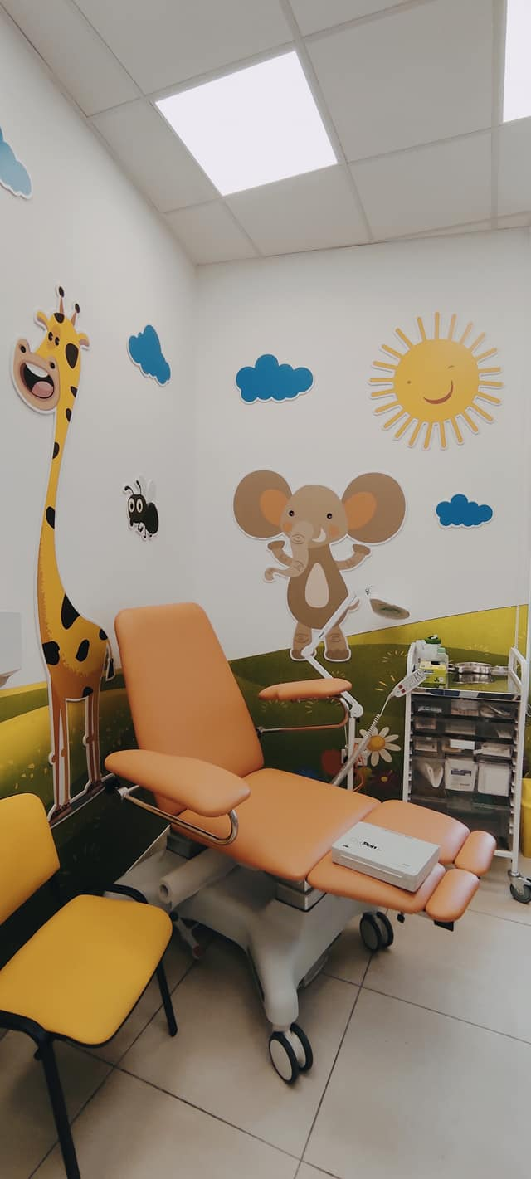
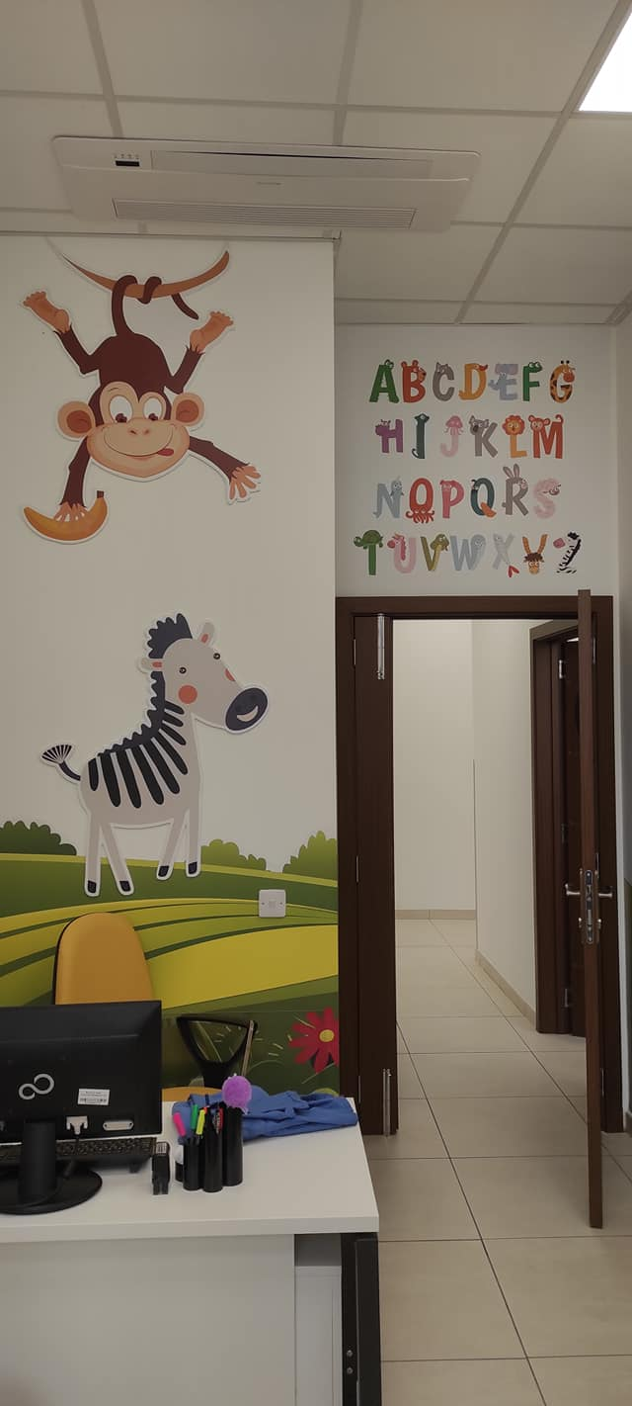
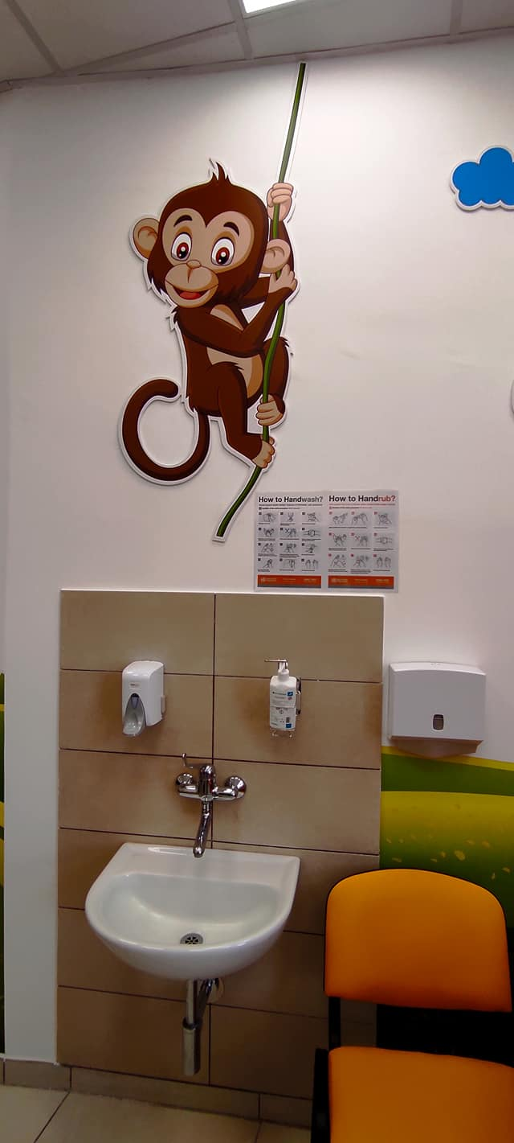
Podopaediatric clinic

Slide 5
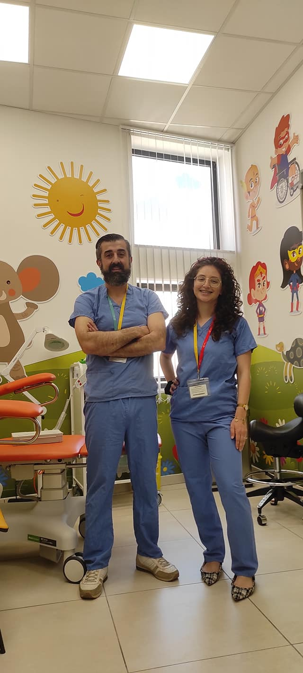
The Podopaediatric team
Mr. Ivan Farrugia
Ms. Roxanne Agius

Slide 6
Definition of Podopaediatric practise
Podopaediatrics encapsulates the diagnosis and management of paediatric foot disorders and their associated effects upon the lower limb and the child in general
Involves assessment of the lower limb and associated axial skeleton in health and disease and the evaluation and treatment of conditions that may be isolated to the foot, or manifestations of systemic disease

Slide 7
………….continued
This involves a specialist approach to the care of the child separate from that involving assessment and care of the adult.
Care transverses all medical and surgical specialities and takes cognisance of the vagaries of child development, age and the psychosocial needs of the child and parent

Slide 8
Foot conditions and treatments
An array of foot conditions:
Ingrown nails
Heel pain
Biomechanical foot conditions
In toeing gait
Referrals from Scoliosis clinic due to LLD
Overriding and overlapping toes
A plethora of dermatological conditions mostly verrucae and Tinea (hygiene, communal showers)
Onychomycosis
Nail surgery
Cryotherapy using Cryopen. This is done when topical treatment fails

Slide 9
Excessive Pronation
When standing, pronation occurs as the foot rolls inwards and the arch of the foot flattens, hence the term often used to describe someone who over pronates as having 'flat feet‘
Pronation is a normal part of the gait cycle which helps to provide shock absorption at the foot
Excessive foot pronation (flat feet) with concomitant knee internal rotation and adduction can lead to a chain reaction of muscle imbalances throughout the kinetic chain, leading to foot and ankle, knee, hip and low back pain
Notes:
Meta sieq tinqeleb il gewwa u naraw kwazi jew tmiss ma lart u hemmek hafna jsejhula flat feet ghalkemm hem lacuna jekk vera tizistix flat feet
Huwa normali sieq tinqeleb
Ghalkemm hafna drabi meta sieq tinqeleb wisq tista tikkawza ugih u zbilanc

Slide 10
Excessive Pronation
Can lead to internal rotation stresses at the lower extremity and pelvis, which may lead to increased strain on soft tissues (Achilles tendon, plantar fascia, patella tendon, IT-band) and compressive forces on the joints (subtalar joint, patellofemoral joint, tibiofemoral joint, iliofemoral joint, and sacroiliac joint), which can become symptomatic
Thus it is of utmost importance to identify and classify excessive pronation and treat accordingly
Notes:
Tikkawza stress fuq joint kif ukoll tendons li jistaw jikkawz ugih u anke deformititajit
Ghalekk limportanza li tikklasifika flat u tara liem trid tati iktar attenzjoni
Ghalekk limportanza li nuzaw screening jew nigbru informazzjoni li jkoll evidenza fuq studji…nigu alija iktar tard

Slide 11
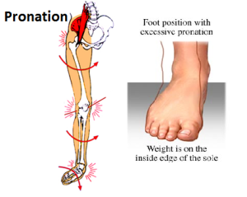
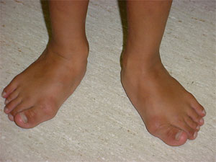
Excessive Pronation

Slide 12
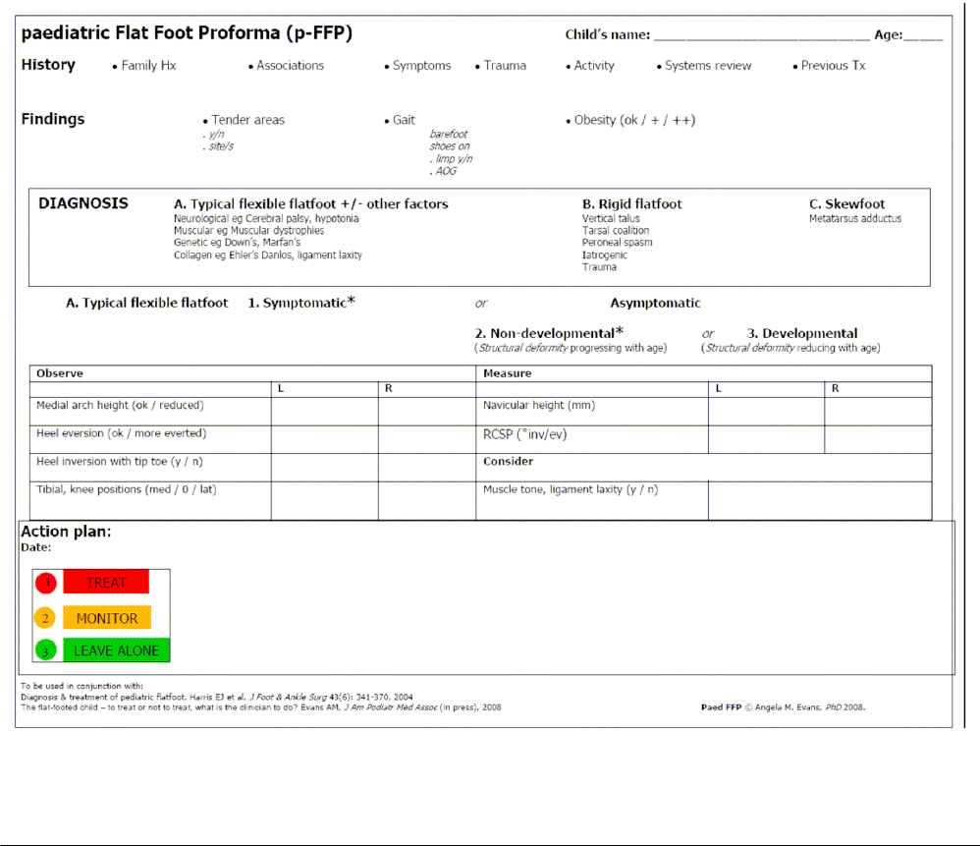
p-FFP
Notes:
Din hija tool li nuzaw biex narw jekk nittrattawx, nimmoniterjawx jew inkella sahansitra ma jsir xejn rigward flatt feet.
Hija komplessa u dettaljata ghaliex limportanza li tkun korrett fuq trattament

Slide 13
Foot Scan Analysis
A Foot scan is a form of advanced technology in measuring pressure and force distribution accurately, at high speed and high resolution
The data collected is very sensitive to change. It provides a clear clinical picture and objective measure of an individual’s static, standing balance, through measurement of the level of postural sway, weight distribution through the feet, and location of the centre of gravity.
Notes:
Footscan hija ghodda biex nikkalkulaw pressure u firza li tigi trasmessa mis siq
Dan jista jsir kemm bmod statiku (wieqaf) u kemm dak dinamiku (miexi)
Linformazzjoni li tingabar hija sensittiva hafna fi sens li tati stampa cara hafna ahjar meta bcertu ghodda ohra jinholqu incertezzi
Tintuza liktar ghal studji wkoll

Slide 14
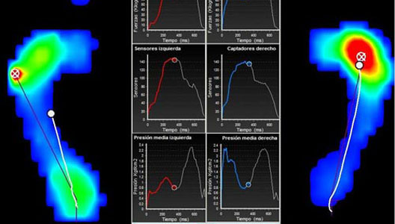
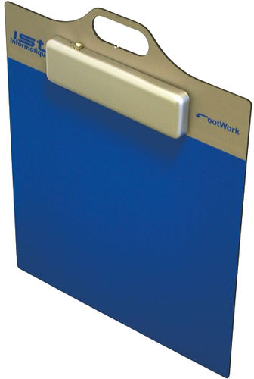
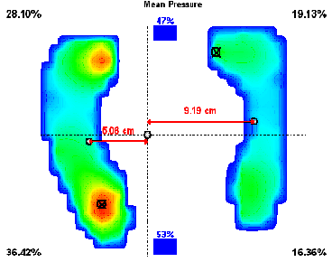
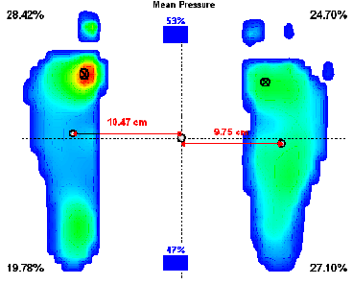
Portable Foot scan

Slide 15
Leg Length Discrepancy
Leg length discrepancy (LLD) causes pelvic obliquity in the frontal plane and lumbar scoliosis with convexity towards the shorter extremity
Leg length discrepancy is observed in 3-15% of the population
Unequalised lower limb length discrepancy leads to posture deformation, gait asymmetry, low back pain and discopathy
Limb length discrepancy is usually not large (about 1 cm) and is observed in about 3-15% of the population
The reasons for the occurrence of such a difference are not known in 95% of cases
Notes:
Jhekk inkejlu lil xulxin hawn gew insibu li kollha kemm ahna ghanda sieq iqsar min ohra
Pero certu diskrepanzi jistaw jikkawzaw deformita fil posizzjoni tal gisem ezempju flsipina ta dar

Slide 16
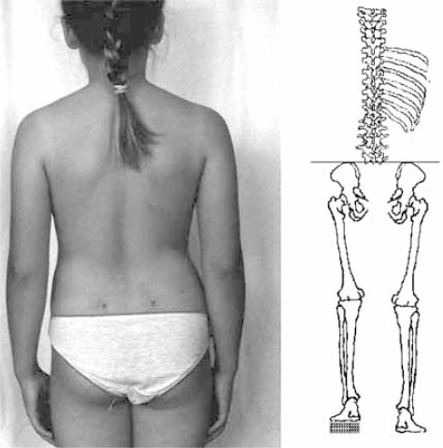
Leg Length Discrepancy
Notes:
Hawn qed naraw picture fuq diskrepanza ta sieq u kif qed taffetwa dar

Slide 17
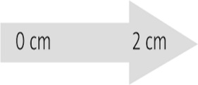
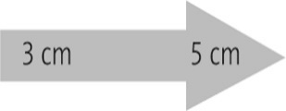
Treatment options for LLD depending on the discrepancy level (acc. to Dahl, 1996 – modified)
Internal lift external lift
Shortening of longer limb:–
epiphysiodesis
osteotomy
Lengthening of shorter limb
Combined lengthening of shorter and shortening of longer limb
Prosthesis
Notes:
Hawn qed naraw fazijit ta trattamenti skont discrepanza

Slide 18
Hypermobility
Hypermobility or generalised joint laxity is defined as a condition in which most of an individual’s synovial joints have a range of motion beyond normal limits
The prevalence of hypermobility in schoolchildren has been estimated to be 13–26.5%, with a higher prevalence in girls than boys
Benign joint hypermobility syndrome is traditionally thought of as being a benign condition consisting of generalised joint laxity with non-specific musculoskeletal complaints.
In some sports, hypermobile joints may be associated with a performance advantage—for example, spin bowlers in cricket, gymnasts, and ballerinas
However, previous studies have revealed an increased incidence of musculoskeletal complaints such as arthralgia, joint subluxations, joint dislocations, and sprains in sportsmen with hypermobile joints
Notes:
Meta il gogi jiggebdu iktar milli suppost nsejhuwla wkoll double jointed
Vantagg fcertu sport zvantagg fiehor ghax jista jikkawz kemm ugih kif ukoll injuries

Slide 19
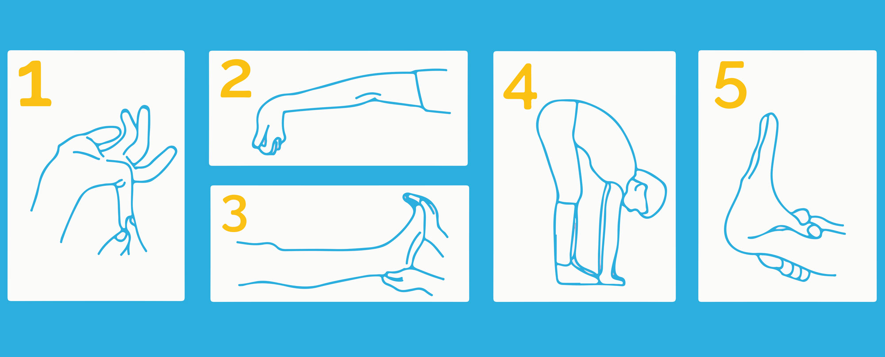
Hypermobility
Notes:
Beighton score explain

Slide 20
Sever’s disease
Sever’s disease is an inflammation of the calcaneal apophysis
The calcaneal apophysis is a cartilaginous growth center onto which the Achilles tendon inserts
The generally accepted clinical picture of Sever’s disease is that of an active male child 10 to 12 and female 8 to 10 years old, often presenting at the beginning of a sport season, experiencing a growth spurt, and experiencing pain over the apophyseal area of one or both heels
Notes:
Ugih flarqub komuni iktar fil boys milli girls
Jitwalu fdaqqa

Slide 21
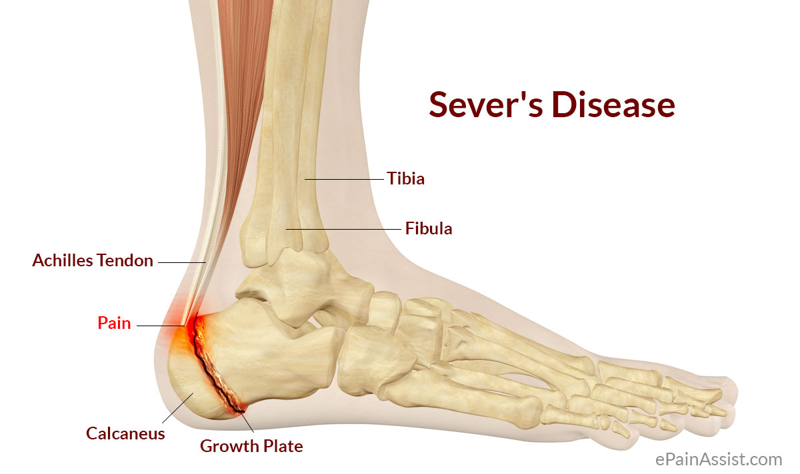
Sever’s disease

Slide 22
Juvenile Hallux Abducto Valgus
Hallux valgus is a common foot problem which, in its early stages, will affect just the first metatarsophalangeal joint
It is likely that hallux valgus is not a yes or no phenomenon but rather represents a continuum of variable severity
It can also be associated with abnormal foot mechanics, such us a contracted Achilles tendon or a severe pes planus
Juvenile hallux valgus deformities have been characterized by their familial tendency and in the past, different authors proposed that this trait was autosomal dominant with incomplete penetrance, or with maternal transmission
Notes:
Fattur ereditarju jew ukoll minn hafan pressjoni fuq suba il kbir jew certu strutturi ohra fi saqajn ma jahdmux sew

Slide 23
Juvenile Hallux Abducto Valgus

Slide 24
Dermatological Assessment
Myriad dermatoses can affect athletes
One of the most common cutaneous manifestations of athletic activity are skin infections
Bacteria, viruses, and fungi cause these infections
Many are contagious and may have serious ramifications for team practices and competitions
Knowledge of these infections facilitates implementation of rapid treatment and preventive measures to ensure the least disruption in daily team activities

Slide 25
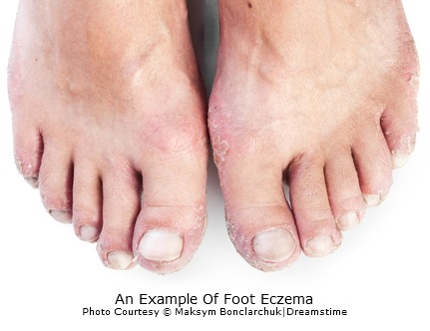
Eczema

Slide 26
Eczema
The prevalence of eczema has increased to levels of public health relevance in the Western world, especially in children
As the most frequent inflammatory condition in childhood, eczema affects physiological and psychological wellbeing of affected children and results in substantial costs
The most common type of eczema is atopic dermatitis
Notes:
Kaz wiehed ta Eczema li kien ukoll assocjat ma dermatitis. Kien fil ginnastika. Jikkontribbwixxi wkoll anke listat tal gilda kemm tixxotta u kemm tinqasam
Ghaliex lisport huwa bla ilquh hafjin so tkun iktar fastidjuza

Slide 27
Tinea Pedis
Fungal infections predominate in the total number of sports-related skin infections
Dermatophytes may infect the foot (tinea pedis) and nails (onychomycosis)
Occasionally, athletes contemporaneously suffer from several types of infection with dermatophytes
Tinea pedis (athlete's foot) represents the most common cutaneous fungal infection in athletes
Myriad epidemiologic studies document the greater prevalence of tinea pedis among athletes compared with non-athletes
Notes:
Moffa fi saqajn. Sibni 6 kazijit ta tinea pero lebda ta onychomycosis. Jista jkun ukol fatt li din kondizzjonjit taffetwa anke liktar nies kbar fleta.

Slide 28
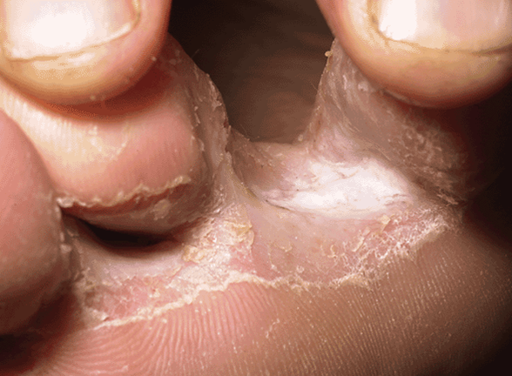
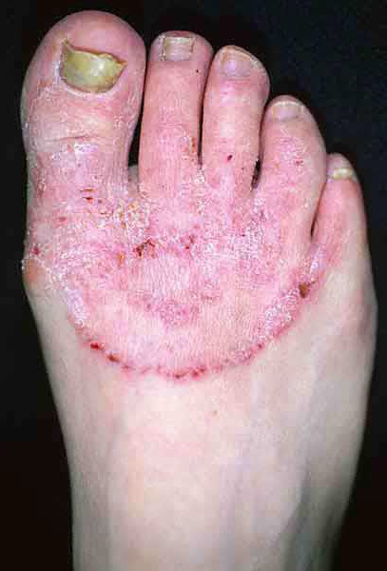
Tinea Pedis

Slide 29
Onychomycosis
Onychomycosis is commonly seen in conjunction with tinea pedis or may occur secondary to trauma to the nail
Although the exact incidence of onychomycosis is unknown, studies suggest that between 2% and 26% of the general population world-wide are affected
Infections appear to be least common in children, but when they occur in these younger subjects they are frequently misdiagnosed
Notes:
Kif konna qed nejdu alkemm tinea pedis tista iggib funal nails fdin liskola ma sibna lebda kaz ta fungal nail. Ma jfissirx ma nisbux ghax kif qed naraw tajjeb anke licken daqqa tista tikkawza difer li jinqala u jimmoffa

Slide 30
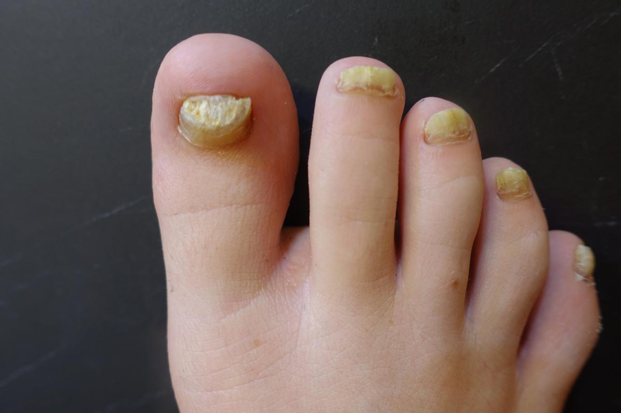
Onychomycosis

Slide 31
Verrucae
Verruca can occur on any skin surface and can be transmitted by direct contact, but shared showers and locker room floors may also act as reservoirs
They can range in size from a pin prick right up to covering large areas of the foot
Sometimes they appear as a single area and sometimes multiple verruca can form over a large area.
Initial and quick diagnosis is beneficial so treatment can start early
Notes:
Ugih ta ras kif ukoll ugih fi saqajn ☺ Warts jew verrucas huma komuni hafna u alkemm jittihdu 90% dejjem ifiqu bi trattament
Alekk limportanza li tilhaq mill bidu. Nista nejd li clinic qed quddiem changing room u il hin li nkun hawn dejjem tara maids dehlin u hergin inaddfu.
Pero il fatt li shower, lockers, pools huma communial areas dejjem jizdid riskju.
Ukoll incubation period 6 months

Slide 32
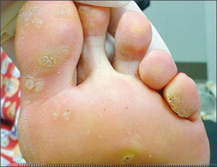
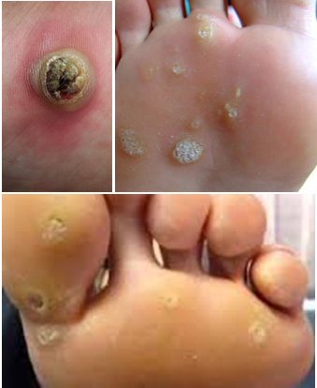
Verrucae

Slide 33
Hyperhidrosis
Hyperhidrosis is a disorder of excessive sweating beyond what is physiologically necessary for thermoregulation
Hyperhidrosis occurs in both children and adults, with the average age of onset of primary hyperhidrosis being 14–25 year
This disorder can be detrimental to a patient’s social, professional, psychological, and physical well-being
Notes:
Hafna gharaq jista jaffetwa kemm fizikament u psikologikament. Anke flisport tista iggib infezzjonjit jew sahansitra injuries fkaz li sport frekwentat bla ilquh
Trattementi jezistu imam leffet temporanju bhal Iontophoresis jew botox injections blocking signals from brain to produce sweat

Slide 34
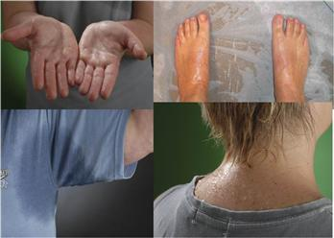
Hyperhidrosis

Slide 35
Callosities and corns
Inappropriate shoes, abnormal foot mechanics, and high levels of activity produce pressure and friction that lead to corns and calluses
Most lesions can be managed conservatively by proper footwear, orthoses, and, if necessary, regular paring
The lesions usually disappear when the causative mechanical forces are removed
Surgery is rarely indicated and should be specifically aimed at correcting the abnormal mechanical stresses
Notes:
Limbirkin kallijit alkemm li sibna hawn kienu kollu hard skin min habba friction li issir mi zraben tal football. Pero kull ma sibna 2 footballers min 75. Ma jfissirx 73 lohra mhux ser ikollom hard skin. Zarbun tal football huwa fattur importanti kif ukoll il forma ta sieq

Slide 36
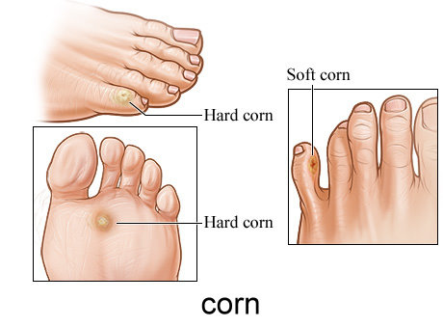
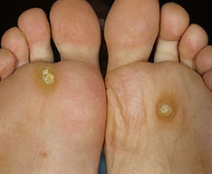
Callosities and corns

Slide 37
Ingrown Nails
Ingrown toenails are one of the most frequent nail disorders of young persons and may negatively influence daily activities, cause discomfort and pain
Today, conservative and surgical methods are available, which, when carried out with expertise, are able to cure the disease
Packing, taping, gutter treatment, and nail braces are options for relatively mild cases whereas surgery is exclusively done by Podiatrists
Notes:
Alekmm hawn qed jghid frequent disorder kull ma sibni wiehd fi skola. Again ma jfissirx li lohraj qatt ma kellhom jew ha jkollom. Limportanza ta screening u presenza ta specjalista tohrog hawn li il fatt li nidentifikaw problema mill bidu.
Rigward din kundizzjoni jsiru hafna prceduri biex jitfejjaq jew jigi salvat id difer imam meta jkun bhal SLIDE NEXT

Slide 38
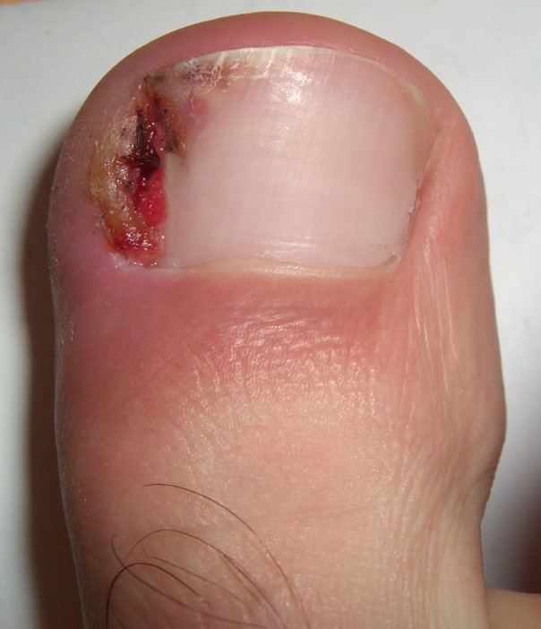
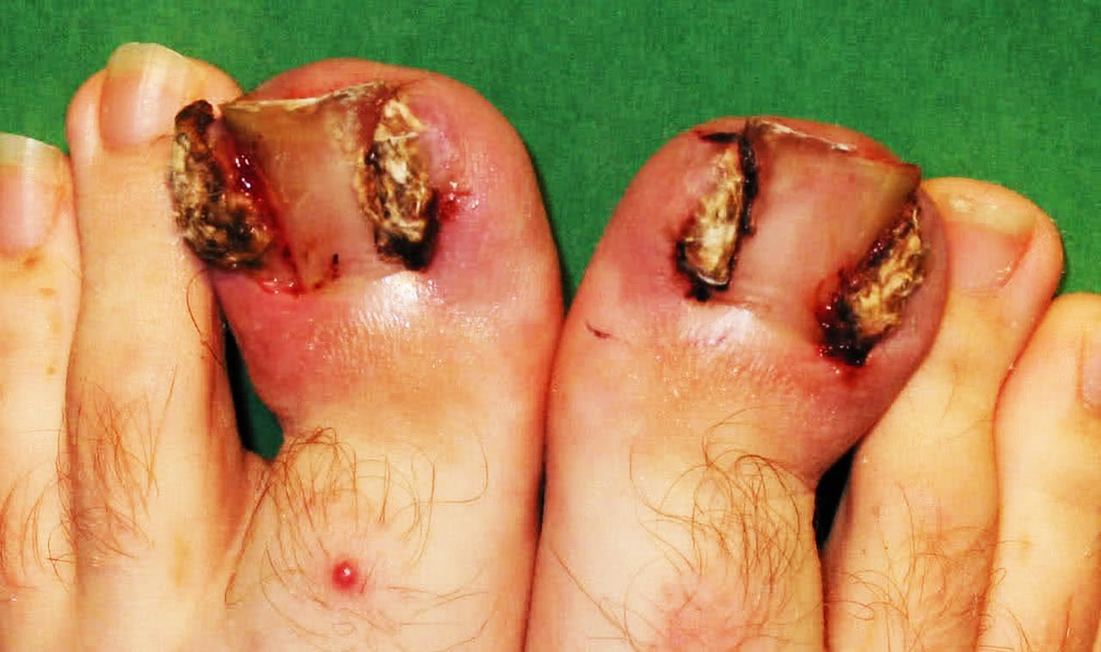
Ingrown Nails

Slide 39
Podopaediatric Clinic today
2012 till date more than 50K app (does not include orthotic treatment)
We are in collaboration with:
Rheumatology MDH
National Sports School
OPU KGH
Paediatric Physiotherapy MDH
Well baby clinic PHC
Schools medical team PHC

Slide 40
Podopaediatric Clinic Primary Health Care FB Page
In the early days of the Covid 19, all special clinics where closed.
We still had the responsibility to keep offering the service the best way we could
With the continuous help and innovative ideas from Ms Rosanne Camilleri, CEO PHC, we initiated an online clinic/contact centre on the PHC FB Page
Parents/guardians who wish to ask/query/book or discuss any Podopaediatric matter had and still have the facility to do so by sending a private message on PHC FB Page, ask for Podopaediatric clinic and Mr Ivan Farrugia will handle all requests.

Slide 41
Podopaediatric Clinic Primary Health Care FB Page
ONLINE CONSULTATIONS FROM 24/04/2020 TILL 27/01/2020
747 online consultations
30% were given online advice and treatment
70% were given an appointment at our clinics
ONLINE CONSULTATIONS FROM 24/04/2020 TILL date
1200 online queries/consultations

Slide 42
Appointments
No referral needed but it helps to keep correspondence with the HCP if requested
B'kara Centre of Excellence/OPU ST Lukes Hospital
Urgent and information queries can be done on the PHC FB page by sending a private message(Ask for Mr Ivan Farrugia)
No Saturday appointments
Once weekly afternoon session (Wednesdays)
Call centre 21231231

Slide 43
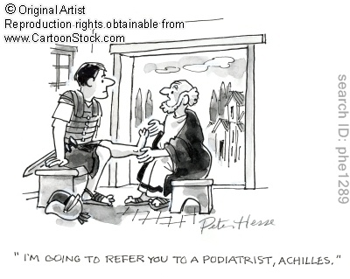
Thank you

